Slide 1
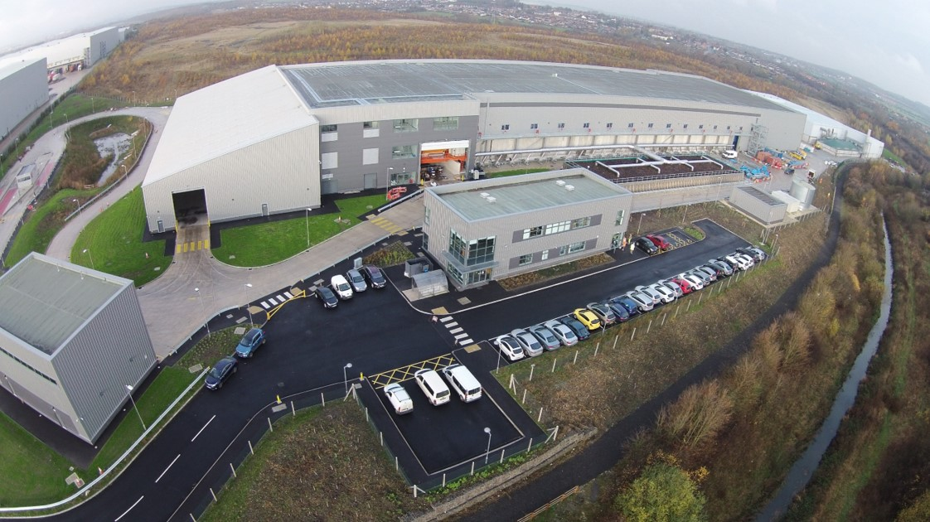

What happens to our rubbish that does not get recycled?

Slide 2
Aims and objectives
To understand how our waste is processed
Success Criteria
I can describe the processes our waste goes through
I can explain the benefits of the waste treatment facility
I understand the importance of recycling at home

Slide 3
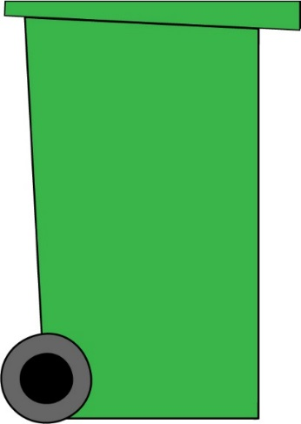
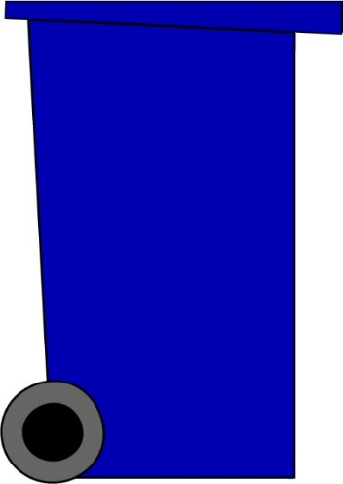
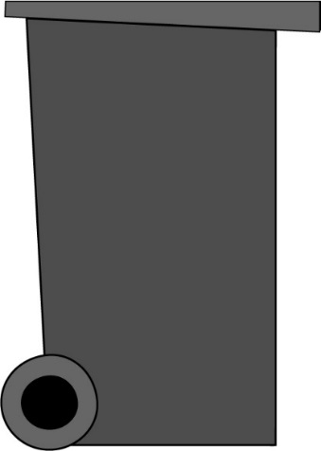
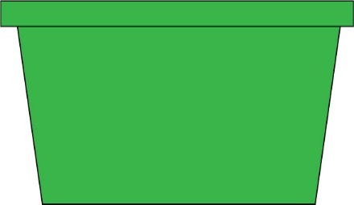
In Doncaster, we have 3 bins & 1 box
The items in these bins are taken to specialist recycling facilities to be turned into new things
The rubbish in this bin is what we are going to look at today
Garden waste
Paper, card, cans, plastic bottles
Glass jars and bottles
…Everything else

Slide 4

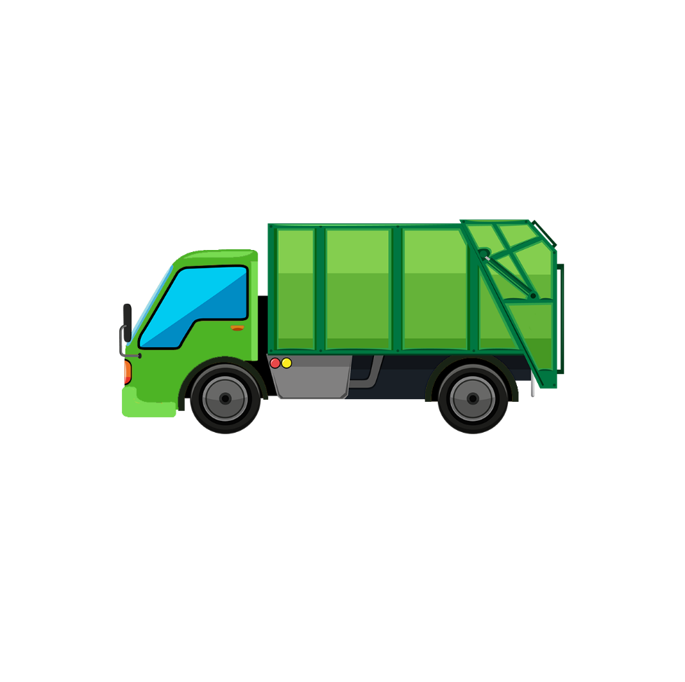
1. Rubbish is collected from your home
The bin lorry will come to your house and collect the rubbish inside your bin

Slide 5

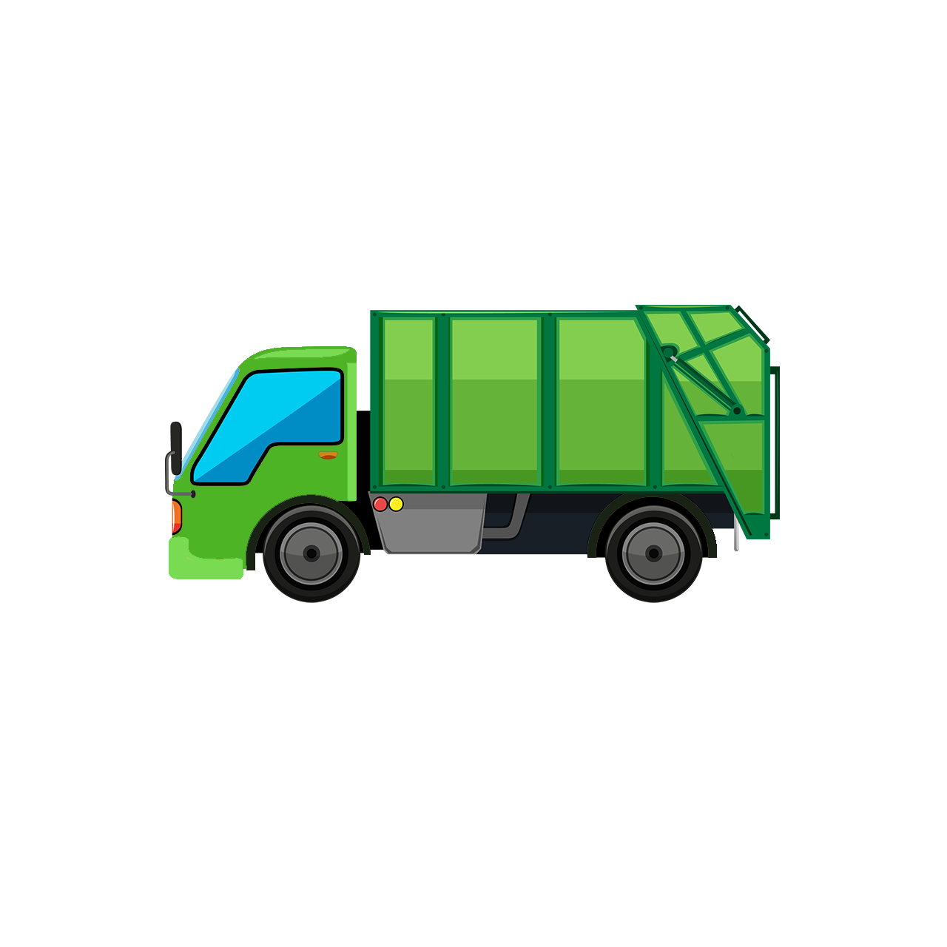
1. Rubbish is collected from your home
The bin lorry lifts up your bin and empties all of your rubbish into the back of the vehicle
It then lowers your bin back on the ground and the bin worker will move it back to where it was
They will keep doing this until the truck is full

Slide 6
2. It is then transported
The bin lorry then travels to the BDR waste treatment facility in Rotherham

Slide 7
2. It is then transported
BDR Waste Treatment facility
This stands for Barnsley, Doncaster and Rotherham
A place where rubbish is processed

Slide 8
2. It is then transported
Although the plant is in Rotherham, it is close by to Barnsley and Doncaster.
This means that the bin lorries don't have to drive too far and can get back out to collecting bins

Slide 9
3. The bin lorry is weighed at the weighbridge
The weighbridge is just like your scales at home, but are much bigger and can weigh heavy objects such as cars and lorries
The bin lorry drives onto the weighbridge and is weighed
Can you think why this is?
Answer:
The bin lorry is also weighed on the way out after it has emptied all of its rubbish
This way, the weighbridge operator can figure out how much rubbish has been collected using a simple calculation
Weight on the way in
Weight on the way out
-
=
Weight of the rubbish
Weighbridge

Slide 10

4. The bin lorry enters the reception hall
The bin lorry then goes to the reception hall. This is a large covered building where they empty their lorries
The doors to the reception hall are interlocking doors meaning that the in door will not open until the out door has fully closed
This stops both doors being open together and helps to stop flies, noise and odour escaping
The reception hall
Entry door
Exit door

Slide 11

5. The vehicle reverses into a tipping bay
The bin lorry reverses towards the pit so that can empty the rubbish into it
To stop the bin lorry falling into the pit, a wheel stop is used
Once the bin lorry is finished, it will exit the reception hall and then go onto the weighbridge again
It will then go back out to collect more bins!
Rubbish pit
Wheel stop

Slide 12
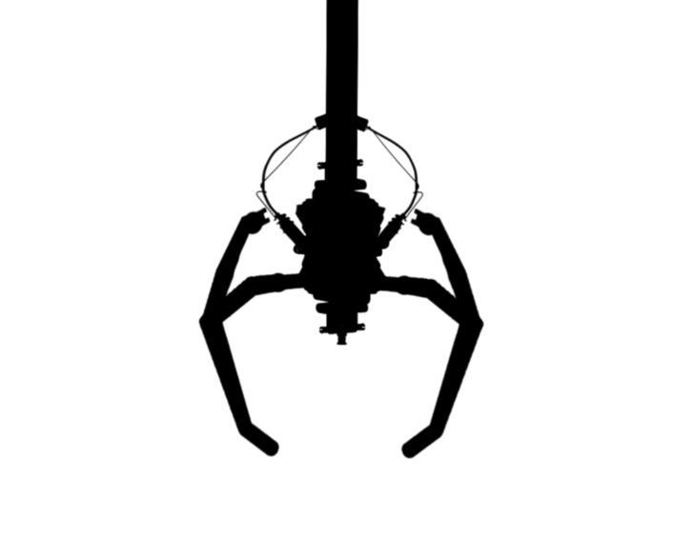
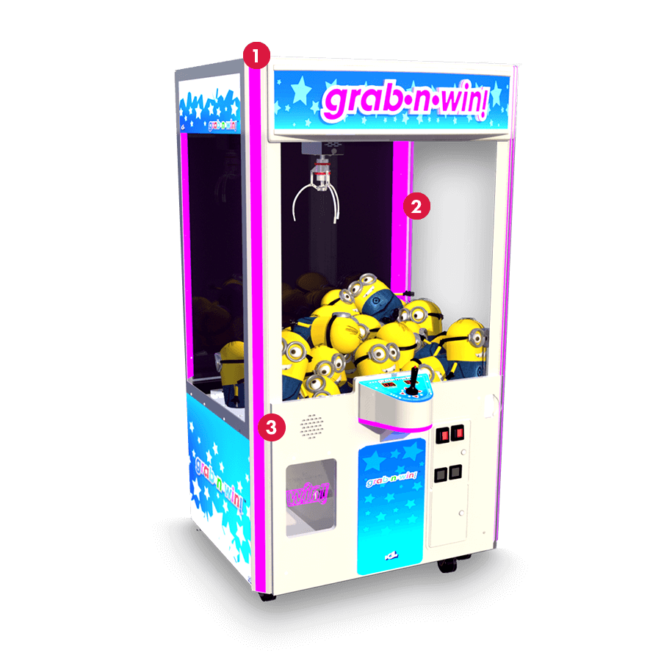
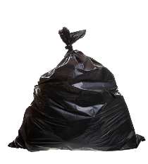
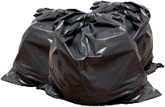
6. The rubbish is moved by a crane
This is just like the crane in the claw machine at the arcade
But it is much larger and can hold 2,500 kg per grab!
Over the day, the reception pit begins to fill up
To stop it overflowing, a crane is used to move the rubbish to the next stage of the process
Reception pit

Slide 13
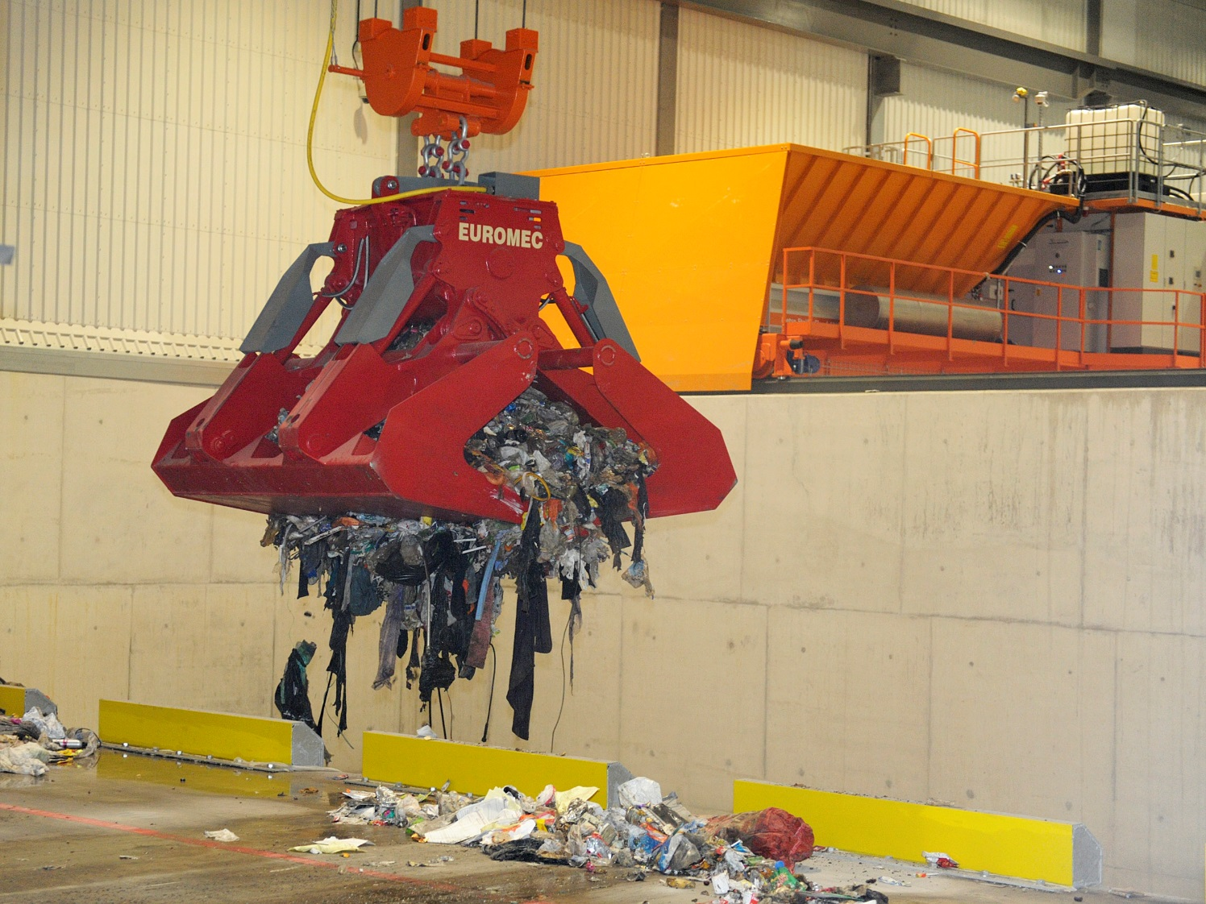
6. The rubbish is moved by a crane
Here is a photo of 1 of the cranes in action

Slide 14

7. The rubbish is shredded
The crane moves the rubbish to the shredder pit
The rubbish is then shredded into smaller pieces using a shredder- like one used for paper, but much bigger and much more powerful!
Can you think why we might shred the rubbish?
Answer:
Our rubbish comes in all shapes and sizes so breaking it up makes the rubbish a similar size and easier to process as everything can fit on a conveyor belt
It also allows any bin bags to be broken up

Slide 15
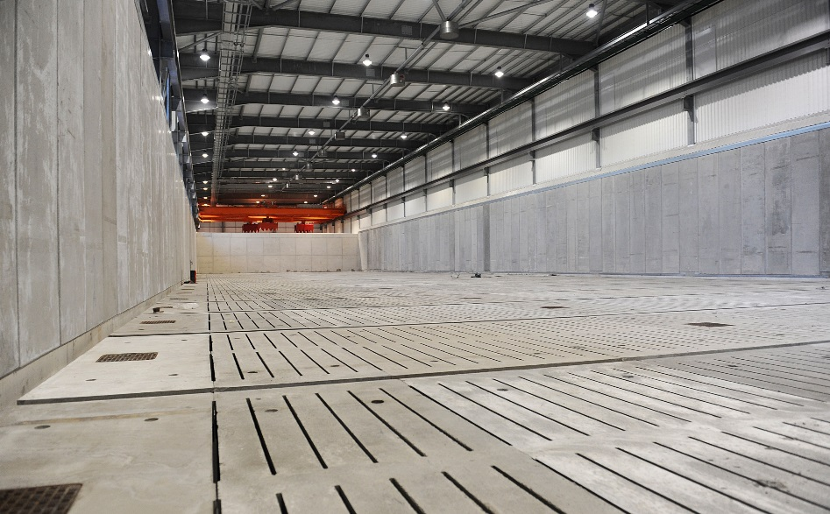
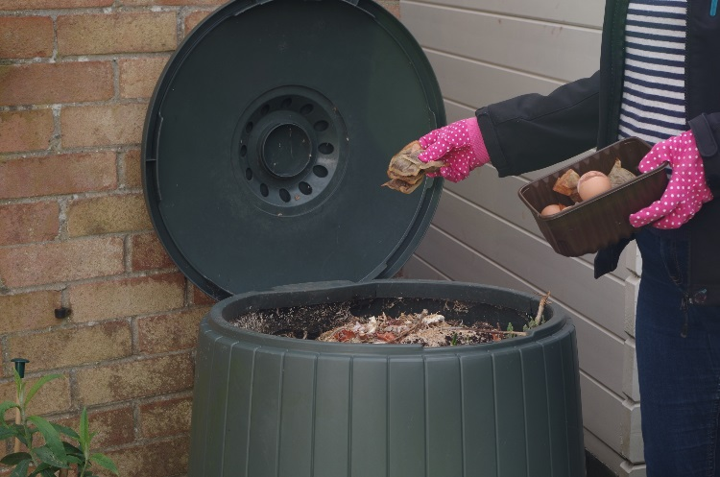
8. The Bio-Drying Hall
Once the rubbish is shredded, it is taken to the bio-drying hall
The bio-drying halls a large building where the rubbish is left to rot or biodegrade for 2 weeks
This process is similar in how it happens to dead plants rotting down into compost. The organic waste (food, garden waste, pet poo and wood and paper-based items) break down as they rot
This produces heat and is sped up by warm air being drawn though the waste
This is what the Bio-drying hall looked like before any rubbish was added

Slide 16
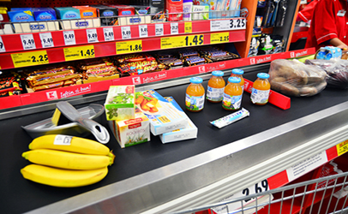
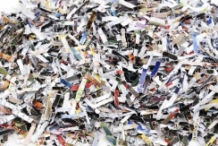
9. Conveyors
We move the waste using conveyor belts. This makes the process quicker and safer as there is no need for a person to touch the waste
A conveyor belt is a simple machine made up of a rubber belt wrapped around 2 rollers
This is how the conveyor belt you put your shopping on in the supermarket works too
Belt
Turning one of the rollers with a simple motor makes the belt move and carries the waste along the conveyor belt. The yellow arrows in the diagram show the direction of movement
Rollers

Slide 17
10. The trommel
Next, we sort the rubbish by size using a machine called a trommel
This is like a giant sieve (like the one in your kitchen) that separates the small pieces of rubbish from the big pieces
The bigger pieces move onto a different conveyor belt
The shredded rubbish enters the trommel
Trommel
The trommel is constantly turning to allow the waste to move to other conveyor belts
The smaller pieces of rubbish fall through the holes and onto a conveyor belt

Slide 18
11. Plastics are separated
Optical sorter
The larger waste that moved through the trommel is dropped onto a conveyor belt that runs through an optical sorting machine. This means that the machine sorts using sight.
Scanner detects plastics
Waste is on the conveyor
Plastic
Conveyor belt
Air pushes the plastic onto a different conveyor
Air cannon

Slide 19
12. Ferrous metals are separated
The rubbish that isn’t made of plastic carries on along the conveyor belt
Magnets are used to separate ferrous metals such as steel and tin from the waste
Not all metals are magnetic, only those like iron, steel and tin, that contain iron. These are called ferrous metals
There are magnets that sit above the conveyor belt and these attract magnetic metals
Magnet
Key:
Magnetic
Not magnetic
Conveyor belt

Slide 20
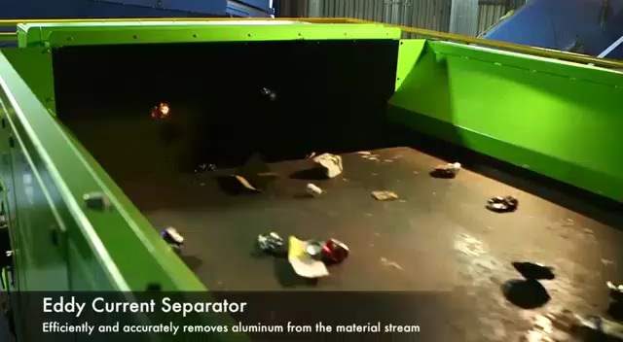
13. Non-Ferrous metals are separated
The waste that is made of non-magnetic metals aren’t attracted to magnets
The next piece of equipment the waste gets to is called an eddy current
This pushes non-magnetic metals like aluminium away from it onto a different conveyor belt

Slide 21
14. Fine materials are sieved
The small waste fraction (that fell through the holes in the trommel) is passed over a vibrating screen
This acts like a sieve that shakes
Bigger pieces move across the surface to the next process
Vibrating screen
Very small pieces fall through

Slide 22
15. Glass is separated
Next we separate the glass out from the organic waste using air
The light organic waste is pushed up onto a conveyor belt
Imagine a balloon and a bowling bowl on a table, if you blow at them both the balloon will move, just like the organic waste does, and the bowling ball will roll downhill if it can
The waste is dropped in to a big tube from half-way up
Incoming waste
The heavy pieces of glass drop down the tube to a conveyor belt at the bottom
Air is blown up from the bottom

Slide 23
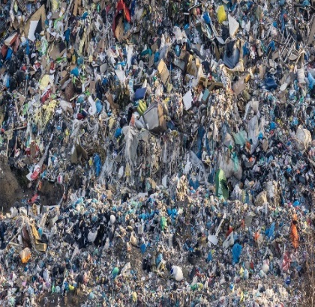

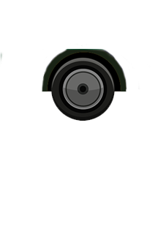
16. Fuel is compacted
Once the recycling has been removed the remaining material is fed into a compactor
It is then compressed to remove air and formed into a large block which can be loaded into an articulated lorry to be taken away and used to generate electricity
Lorry
Compactor

Slide 24
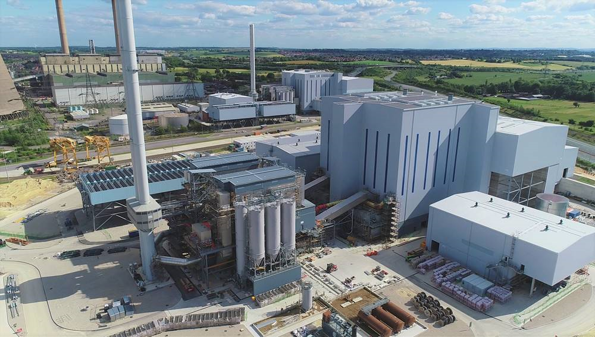
16. Fuel is used for electricity
The fuel is then transported to a power station called Ferrybridge Multifuel in West Yorkshire
Here they can generate enough electricity to power 160,000 homes!

Slide 25
In summary...
Waste is collected by the bin lorries
Waste is transported to the waste treatment facility
The bin lorry is weighed on the weighbridge on the way in and out to calculate how much rubbish is dropped off at the facility
The waste is then separated by size using the trommel
Plastics are separated using an optical sorter
Ferrous metals are separated using magnets
The waste is moved from the reception pit to the shredder using cranes
Ferrous metals are separated using magnets
The waste is sieved again to get out any remaining small particles
The bin lorry takes the waste to the reception hall and empties into the reception pit
Everything that is left is sent to the compactor and will be used as fuel
The rubbish is shredded so that big items break up and will fit on the conveyor
Glass is separated using air
Non-Ferrous metals are separated using an eddy current
The fuel is transported to Ferrybridge power station, where it generates enough electricity to power 160,000 homes!
It is then taken to the bio-drying hall where it decomposes for 2 weeks and any liquid is removed

Slide 26
What are the benefits of the facility?

Slide 27
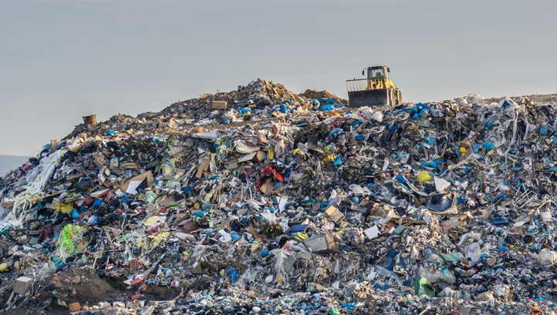
Landfill
In the past, most general waste used to go straight to landfill
This is a giant hole in the ground that is filled up with rubbish
Problems with landfill
Some materials such as plastics can take a long time to bio-degrade naturally
Landfill takes up a lot of space
It is expensive to bury our rubbish in landfill
When rubbish decomposes in landfill it creates a gas called methane, which causes climate change
Facilities like the BDR one were built to help reduce these problem. Since the BDR facility opened over 97% of rubbish has been diverted from landfill
It can effect wildlife and human health

Slide 28
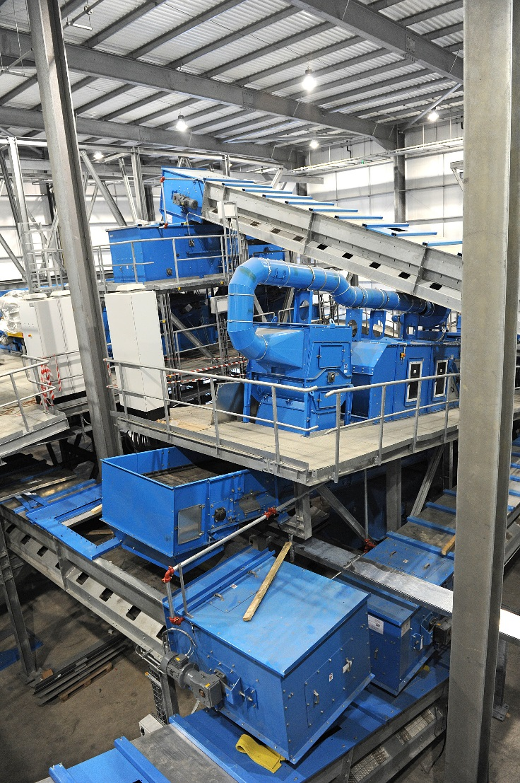
Recycling
By separating out as much recycling as we can at the plant, we can increase the levels of recycling across the area
Some of the materials we separate cannot be recycled using your bins at home such as plastic film and carrier bags and sauce pans

Slide 29
Does this replace recycling at home?
NO!
Imagine if you were running a recycling company-
  Would you want the nice clean recycling that has been washed, squashed and put in the correct bin at home
  Or would you prefer the dirty recycling that has been sitting with food waste, pet poo and nappies for 2 weeks?
Even though both of these can be recycled, it is easier to do so when it is clean. The quality of clean recycling can also be much higher and is worth more money
The facility is not designed to replace recycling a home, but it is there to catch the things we miss or cannot recycle at home!

Slide 30
Remember- right things, right bin!
It is still important for us to put the correct things in the correct bin
If you are unsure, just ask an adult or check your Council’s website!
Garden waste
Paper, card, cans, plastic bottles
Glass jars and bottles
…Everything else

Slide 31
Aims and objectives
To understand how our waste is processed
Success Criteria
I can describe the processes our waste goes through
I can explain the benefits of the waste treatment facility
I understand the importance of recycling at home

