Slide 1

The 3R’s
Reduce, Reuse, Recycle

Slide 2
What is Waste?
Junk
Litter
Garbage
Rubbish
Trash

Slide 3
What is Waste?
Something that is no longer useful to us in its current form

Slide 4
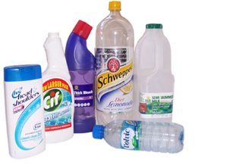
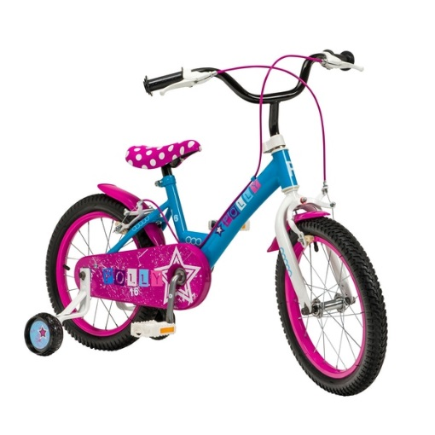
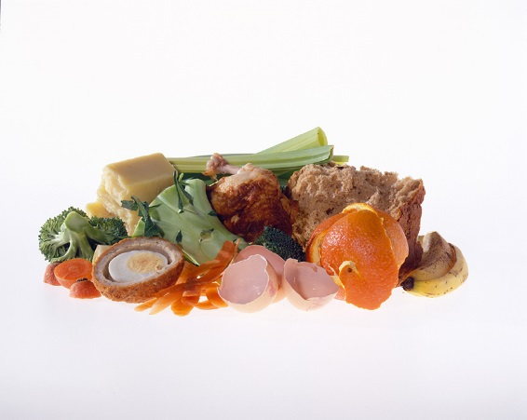
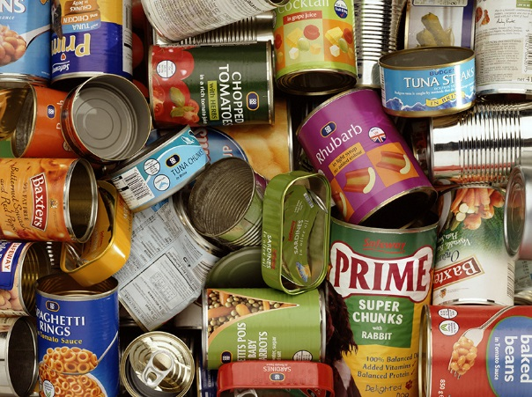
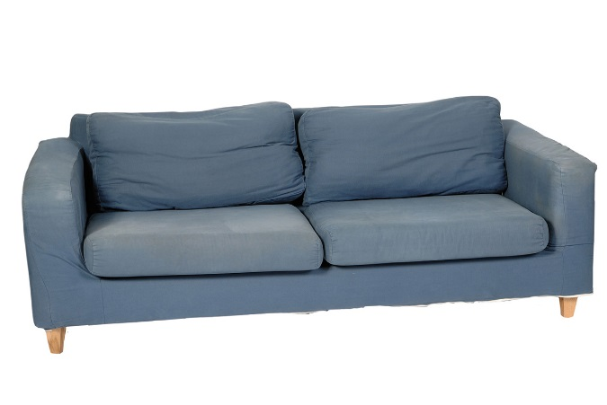
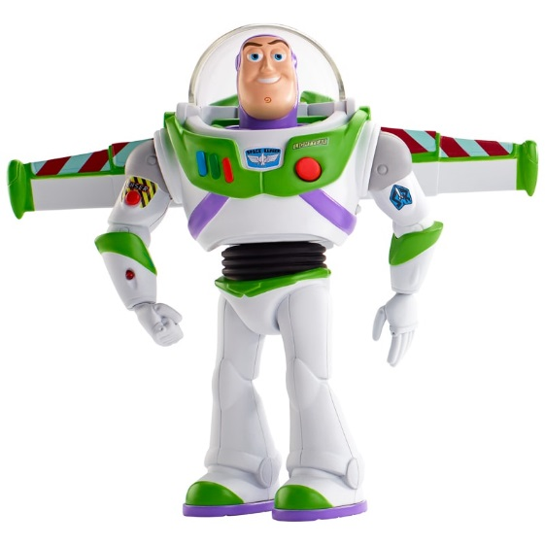
Can you think of any examples?

Slide 5
In the UK we produce
31 MILLION TONNES of waste a year!

Slide 6
31 million tonnes
=
3.5 million Double decker buses!
Notes:
equivalent to the weight of three and a half million double-decker buses, a queue of which would go around the world two and a half times.

Slide 7
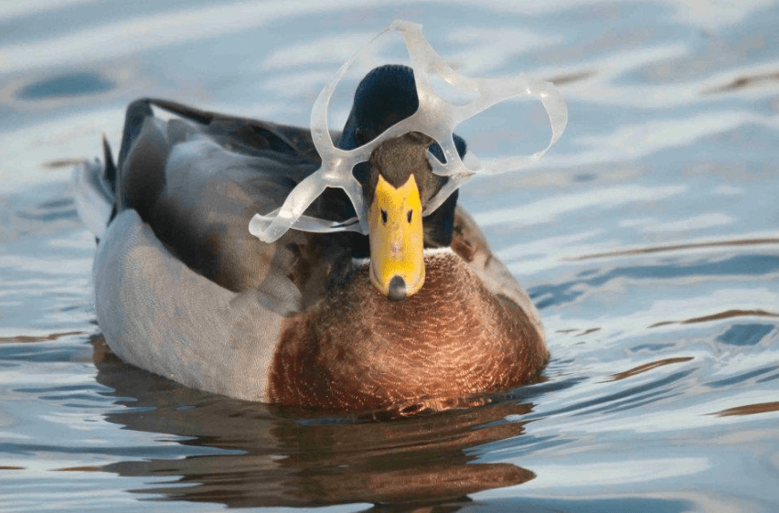
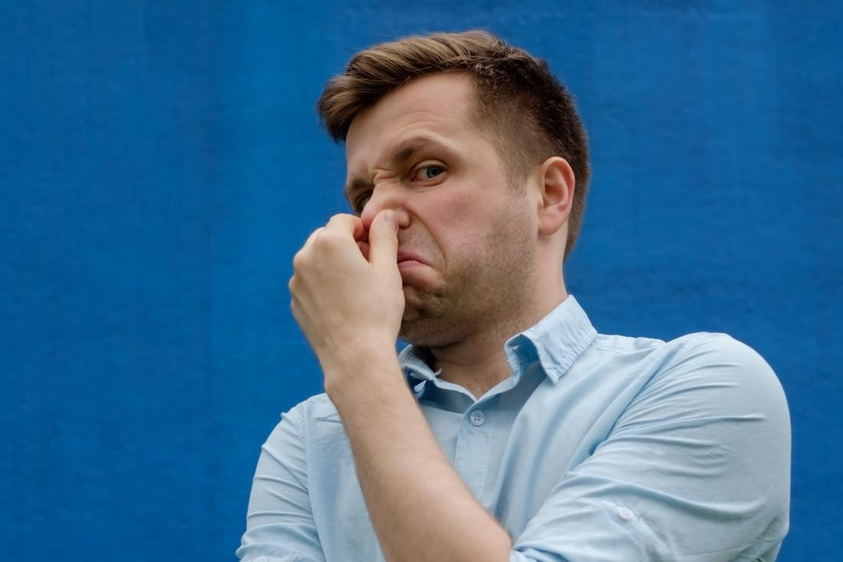
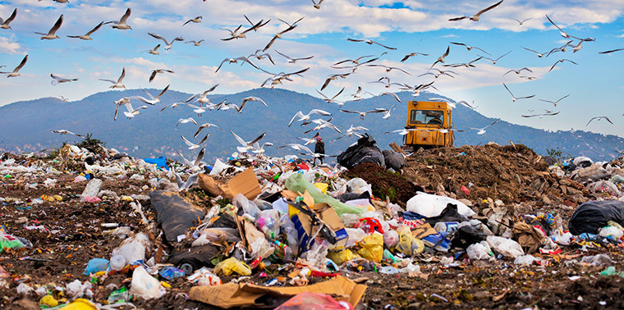
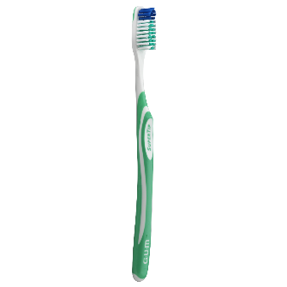
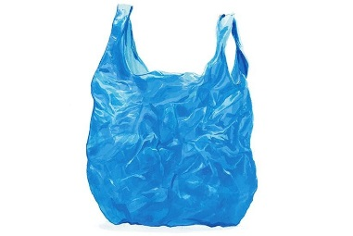
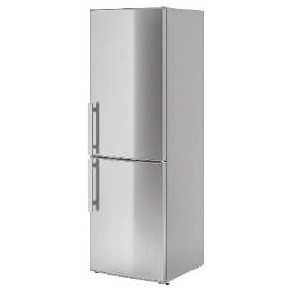

Waste can cause a lot of problems…
It can be very smelly
Takes up a lot of space
Can hurt animals and people
Can be difficult to get rid of

Slide 8
The 3R’s
Reduce
Reuse
Recycle
Make less waste in the first place
Use things again instead of throwing them away
Recycle the correct things as much as possible so that they can be made into new things

Slide 9
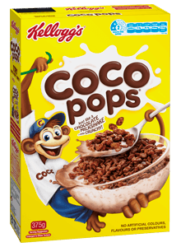
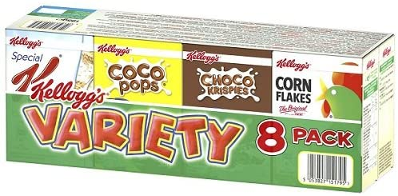
Examples of the 3Rs
Reduce
Think before you buy and only buy things that you need
Think about the packaging before you buy
8 servings
Which will make more waste?
24 servings
8 Cardboard boxes
1 Cardboard box
8 inside bags
1 inside bag
No plastic film
All wrapped in plastic film
£4.00 or 16p a serving
£2.30 or 29p a serving

Slide 10
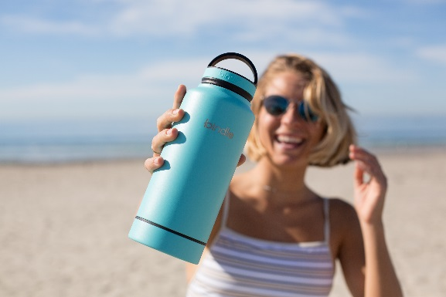
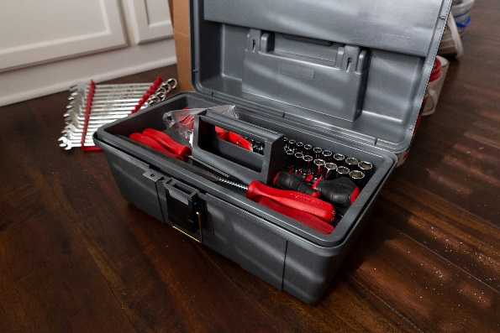
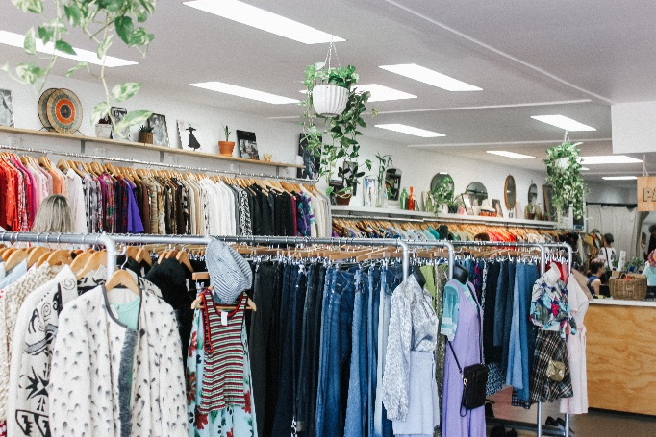
Examples of the 3Rs
Reuse
Using reusable items instead of disposable ones e.g. water bottles and shopping bags
Repairing broken items instead of throwing them away
Buying second hand rather than new e.g. furniture, toys and clothes

Slide 11
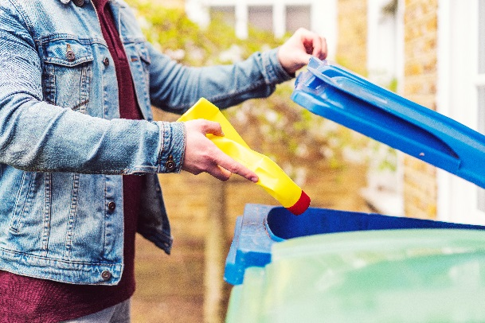
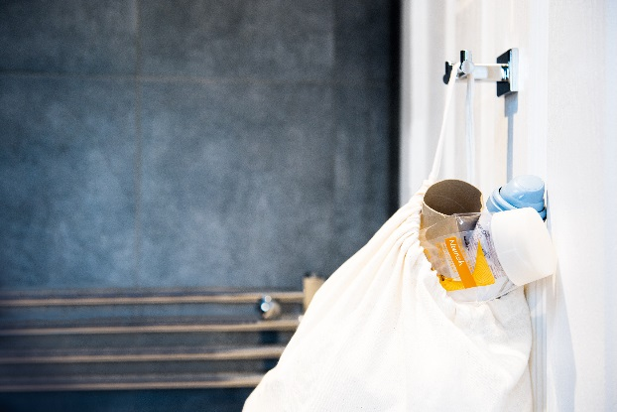
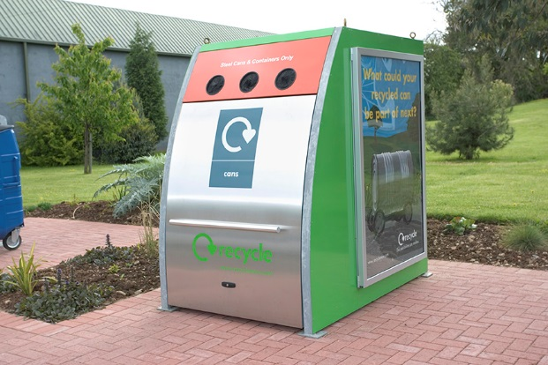
Examples of the 3Rs
Recycle
Putting the correct items in the correct bins at home (and if possible at school)
Keeping a recycling bin in your bedroom or bathroom
Taking your recycling to the recycling centre or bring bank
Raise your hand if you recycle at home

Slide 12
To help bin-workers, we sort our waste into different colour bins

Slide 13

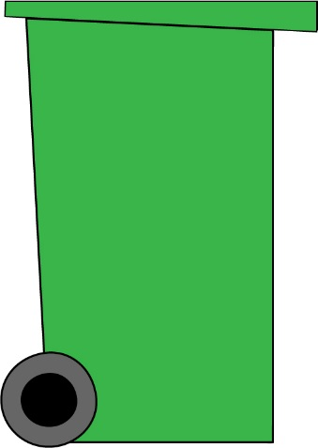



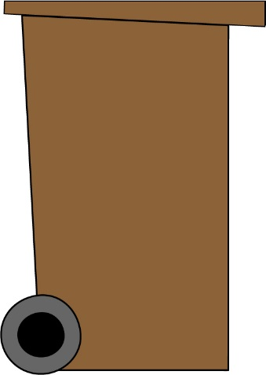
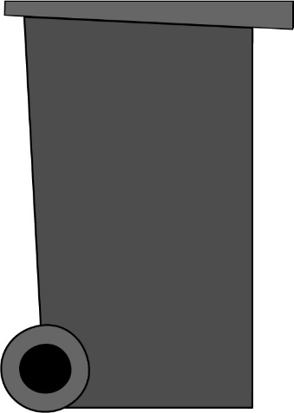
In Sheffield, we have 4 bins
The blue bin
Envelopes
Newspapers
Cardboard

Slide 14



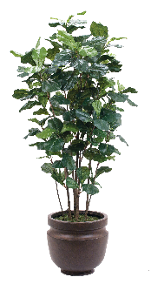

In Sheffield, we have 4 bins
The green bin
Leaves
Flowers
Twigs
Plants
Grass cuttings
Notes:
*Some people don’t have this bin

Slide 15
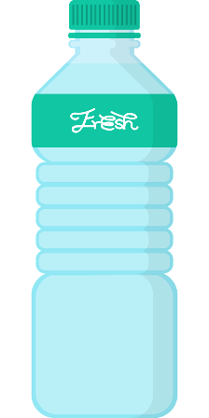
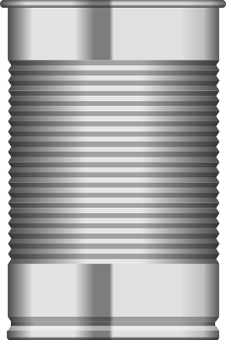
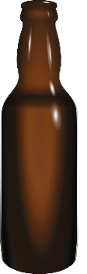


In Sheffield, we have 4 bins
The brown bin
Tins
Plastic
bottles
Cans
Glass jars
Glass bottles

Slide 16

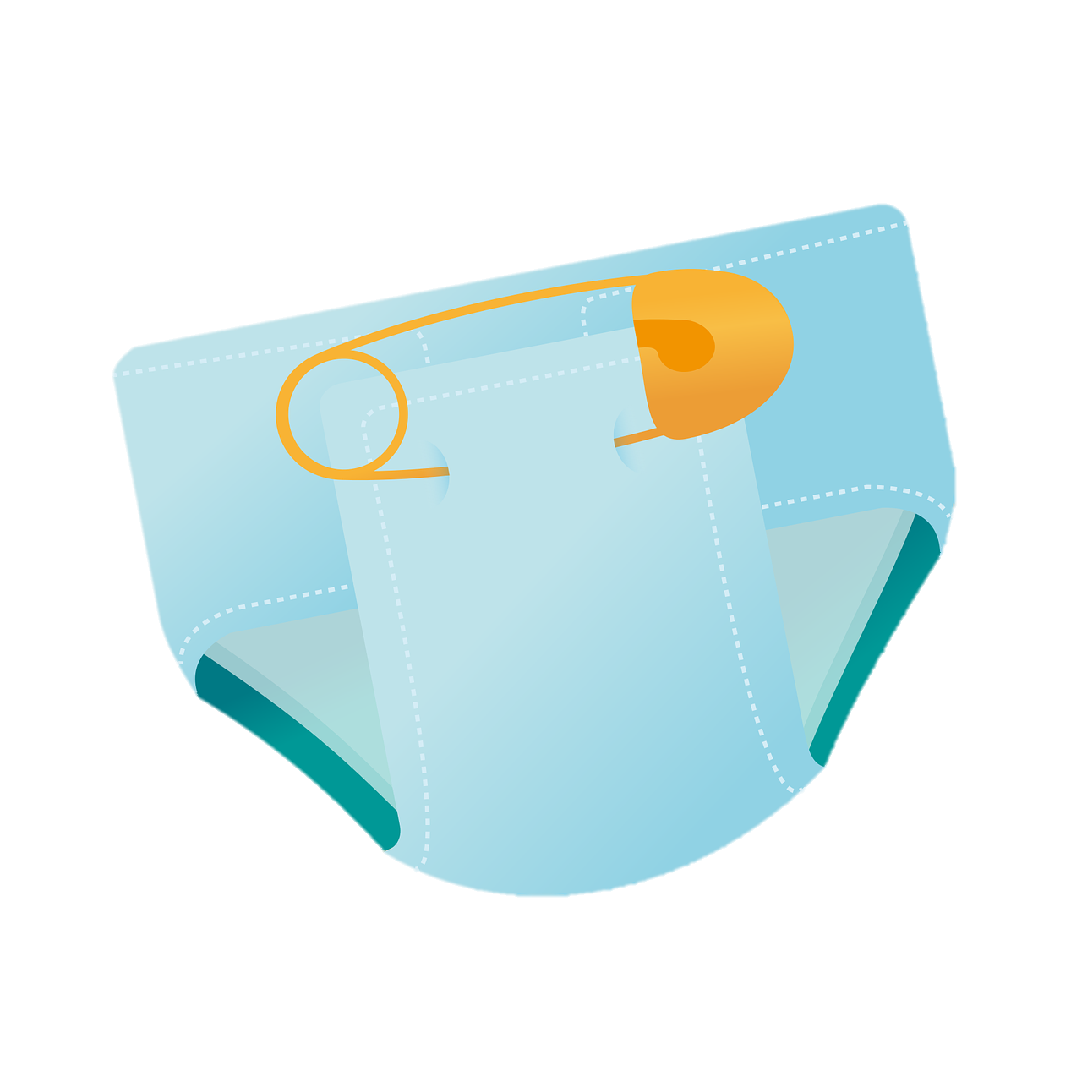
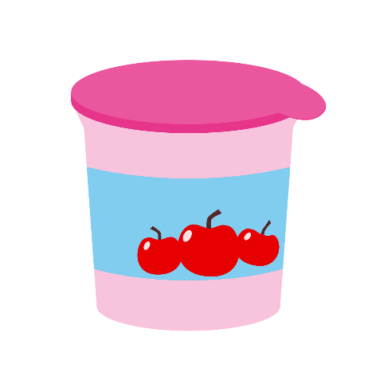
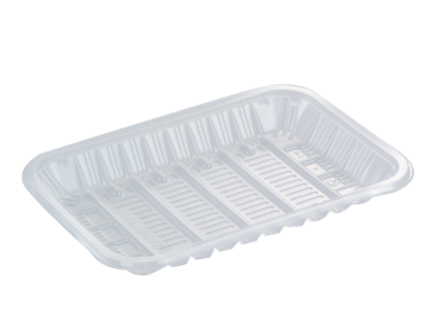
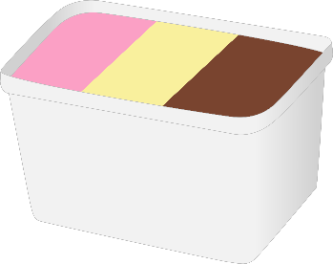
In Sheffield, we have 4 bins
The black bin
Nappies
Food waste
Plastic pots
Plastic trays
Plastic tubs

Slide 17
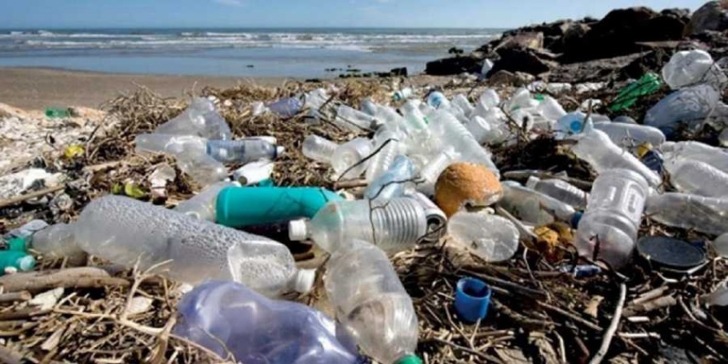
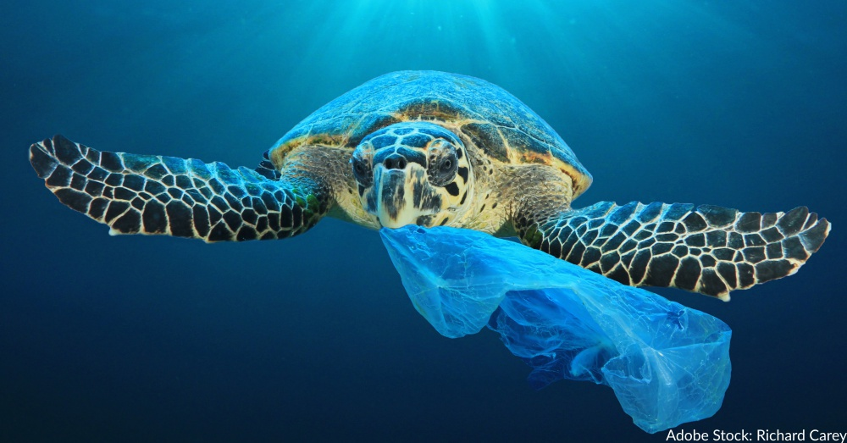
Why should we recycle?
Recycling saves our oceans and beaches!
80% of plastic found in the oceans comes from the land
Many animals in the ocean think that plastic is food and will eat it. This will make them very poorly

Slide 18
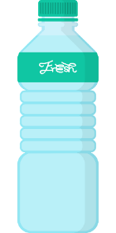
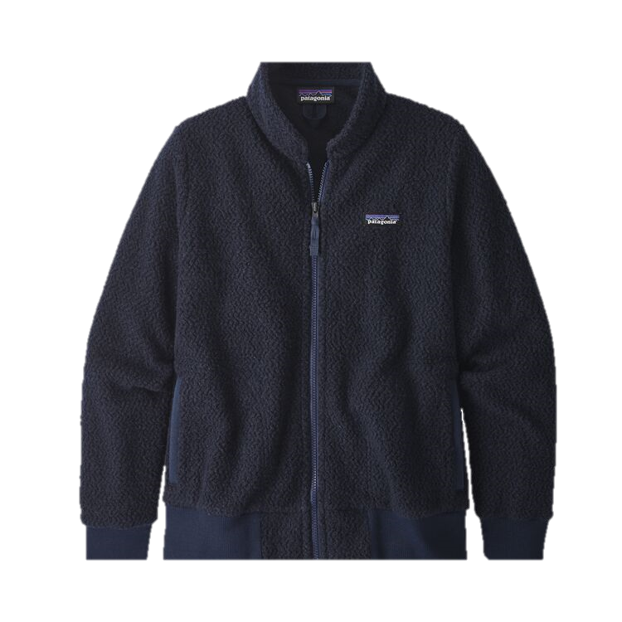
Why should we recycle?
Recycling means we can turn our waste into new things!

Slide 19
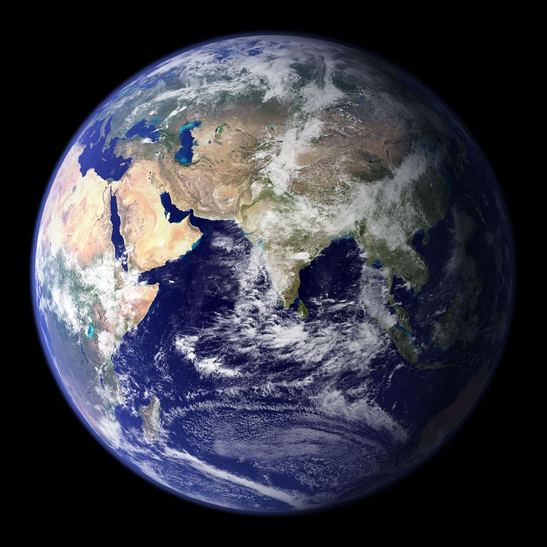
Why should we recycle?
Recycling saves our planet
We only have one planet Earth, so it is really important that we look after it!

Slide 20
How can you help?
Remember the 3 R’s!
Make less waste in the first place
Reduce
Reuse
Recycle
Use things again instead of throwing them away
Recycle the correct things as much as possible so that they can be made into new things

Slide 21
The 3Rs at home and school
Use a reusable water bottle instead of a disposable one
Donate any of your unwanted toys or clothes to charity or give them to friends and family
Use reusable batteries in your toys
Remind whoever does the shopping at home to make a list first and to take their reusable bags!
Put things in the correct bin!- ask a grown up if you're not sure

