Slide 1

The 3R’s
Reduce, Reuse, Recycle
Notes:
This presentation is designed to introduce the 3Rs to key stage 1.
Reduce, reuse, recycle will be phrases they will hear throughout their education and this acts as a soft introduction to the concepts.
This presentation is specific to Doncaster Residents. For other areas, please check out our website.

Slide 2
What is Waste?
Junk
Litter
Garbage
Rubbish
Trash
Notes:
First question to ask your class:
What is waste? You may also hear it called other words such as rubbish, trash, junk, garbage, or litter.

Slide 3
What is Waste?
Waste can be anything we no longer want or need.
Notes:
Waste can be anything we no longer want or need.
This could be because:
We have finished using it
It is broken
We don’t like it anymore

Slide 4
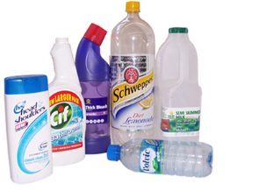
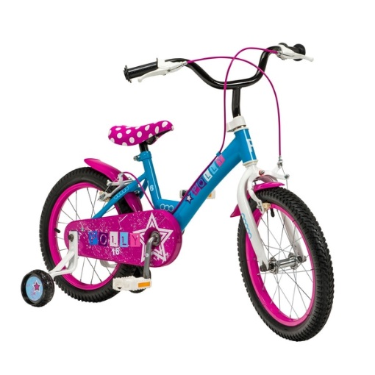
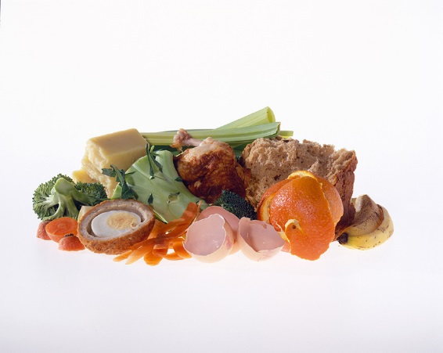
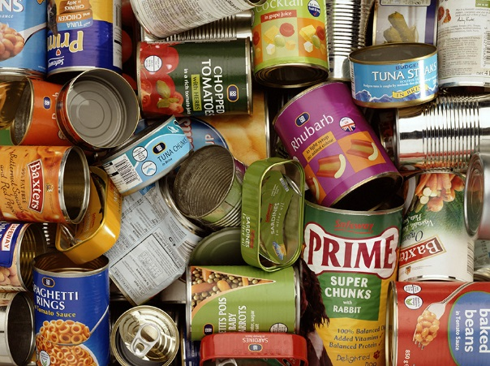
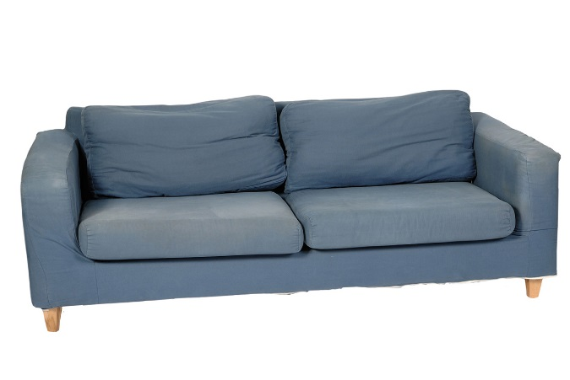
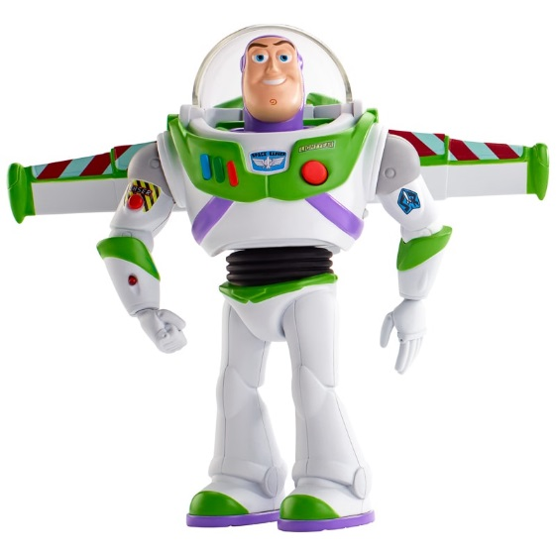
Can you think of any examples?
Notes:
Ask your students if they can think of any things they would call waste?
This is to demonstrate that waste can be ANYTHING! It could be something as small as an eggshell after we have cooked at home or something as big as a sofa we no longer want because it is no longer our favourite colour.

Slide 5
In the UK, households produce
31 MILLION TONNES of waste a year!
Notes:
We make a lot of waste in our country.
In the UK, households produce 31 MILLION TONNES of waste a year!
Do you think this is a lot?

Slide 6
31 million tonnes
=
3.5 million Double decker buses!
Notes:
Equivalent to the weight of three and a half million double-decker buses, a queue of which would go around the world two and a half times.

Slide 7
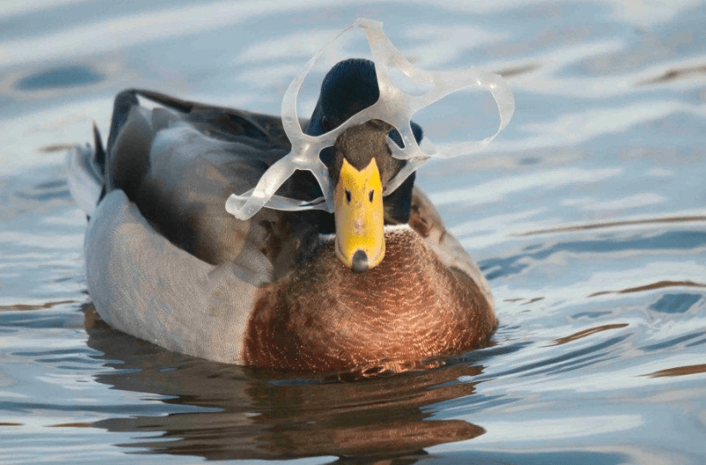
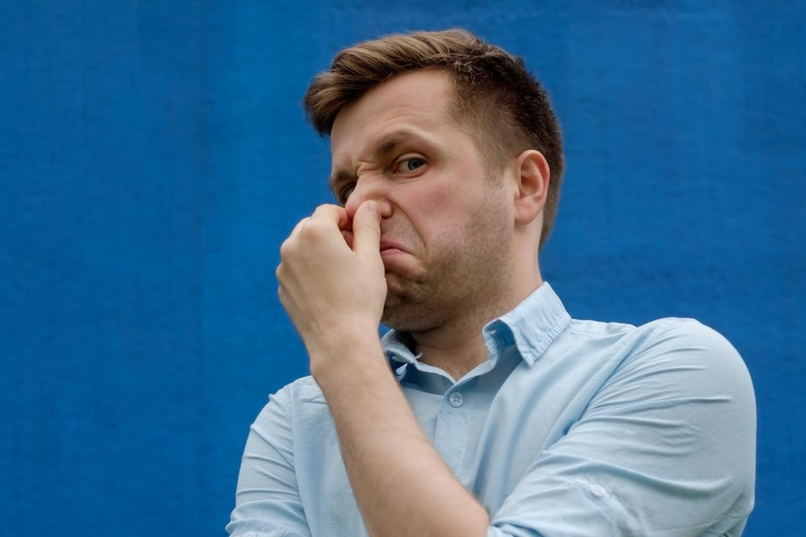
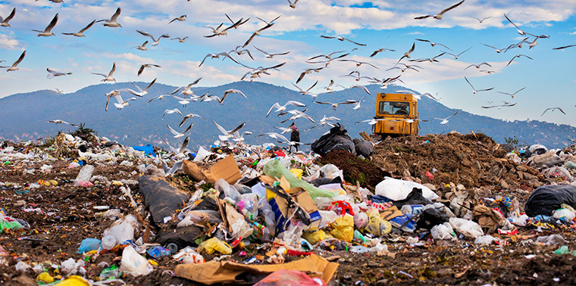
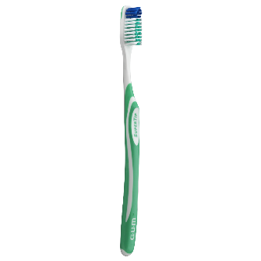
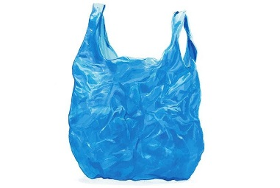
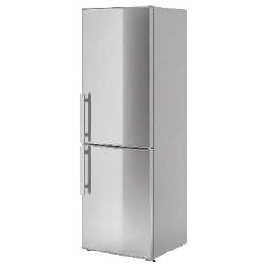

Waste can cause a lot of problems…
It can be very smelly
Takes up a lot of space
Can hurt animals and people
Can be hard to get rid of
Notes:
If not managed correctly, waste can cause many problems
It can be really smelly and not very nice to be around
It can hurt animals and people (e.g. a duck could get caught in a piece of plastic, or a person could trip up on litter)
It takes up a lot of space – in the past, we would get rid of our waste in a place called landfill. This was a giant hole in the ground which would be filled up with rubbish.
A lot of items are made from materials that take a long time to get rid of (e.g. toothbrush and bag are made from plastic, which takes hundreds of years to rot away) and some items are hard to get rid of because they are too big (e.g. fridges and sofas)

Slide 8
The 3R’s
Reduce
Reuse
Recycle
Make less waste in the first place
Use things again instead of throwing them away
Recycle the correct things as much as possible so that they can be made into new things
Notes:
To help stop the problems caused by waste, we use the 3Rs.
This means
Reduce – making less waste in the first place. This is the thing we should try to do first.
Reuse - using things again and again instead of putting them in the bin.
Recycle – putting things in the correct bin so that they can be made into new things.

Slide 9
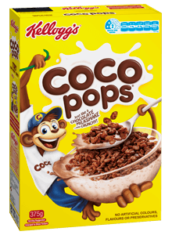
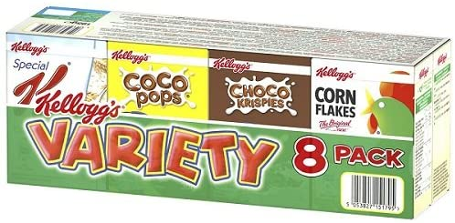
Examples of the 3Rs
Reduce
Think before you buy and only buy things that you need
Think about the packaging before you buy
8 servings
Which will make more waste?
24 servings
8 Cardboard boxes
1 Cardboard box
8 inside bags
1 inside bag
No plastic film
All wrapped in plastic film
Notes:
Reducing means using less and buying less so that we don’t make waste
This could be by thinking before you buy and only buy what you need.
Or look at the packaging on items and picking the one with the least amount of packaging.
We use this cereal example to show that buying the bigger box, even though it is larger, is better than buying the variety pack as it creates less packaging overall.

Slide 10
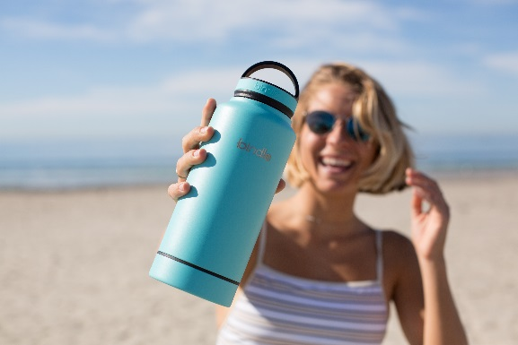
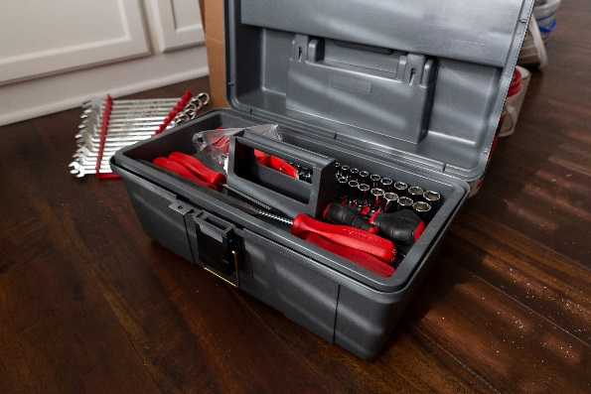
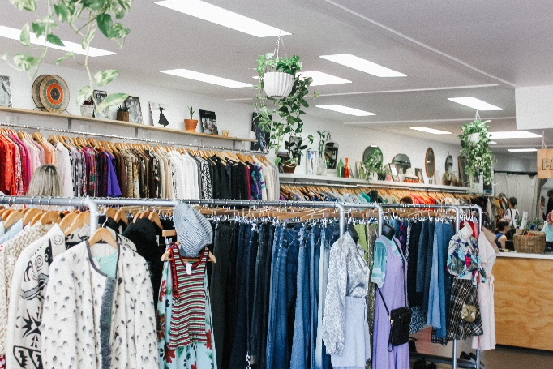
Examples of the 3Rs
Reuse
Using a refillable water bottle
Repairing broken tots and clothes
Taking things to the charity shops
Notes:
Reuse means using things again and again instead of throwing them away!
Using a refillable water bottle
Repairing broken tots and clothes
Taking things to the charity shops
Ask your class if they can think of any other reusing examples

Slide 11
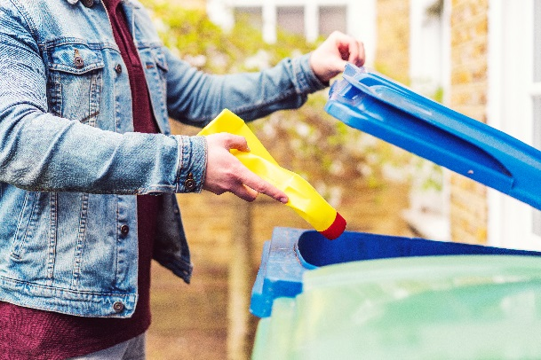
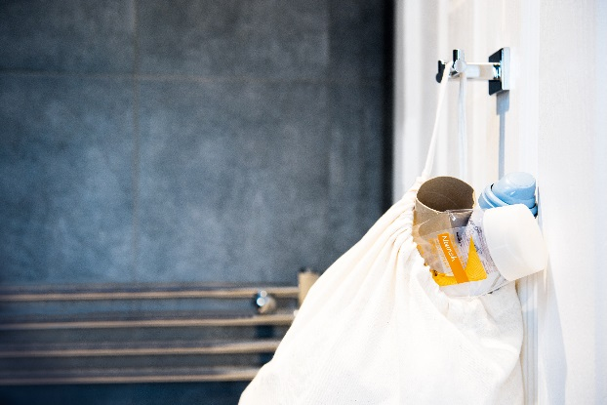
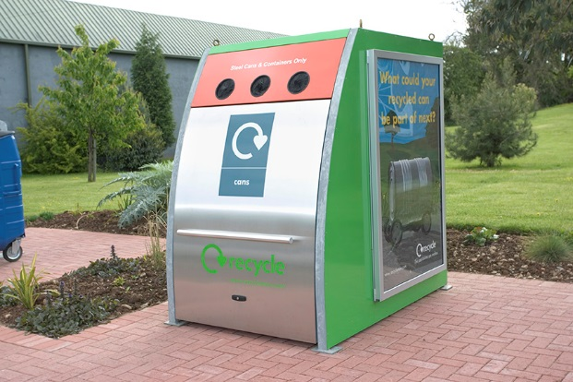
Examples of the 3Rs
Recycle
Putting stuff in the recycling bin at home
Keeping a recycling bin in your bedroom or bathroom
Taking your recycling to the recycling centre or bring bank
Raise your hand if you recycle at home!
Notes:
Recycling means turning old things into new things.
Putting stuff in the recycling bin at home
Keeping a recycling bin in your bedroom or bathroom
Taking your recycling to the recycling centre or bring bank
Ask your class to raise their hand if they recycle at home.

Slide 12
We sort our waste into different colour bins at home!
Notes:
We put different items in different colour bins at home. This makes it easy to recycle the items as they can be separated into different materials more easy.

Slide 13
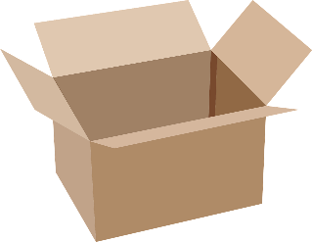
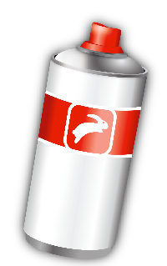


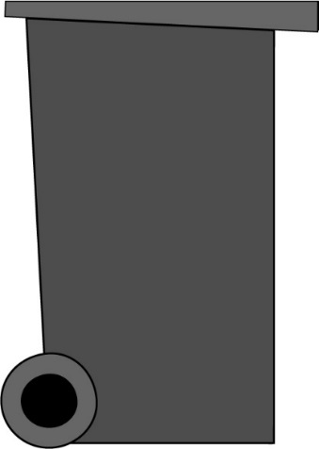
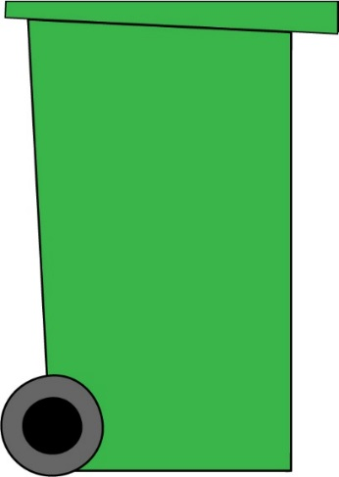
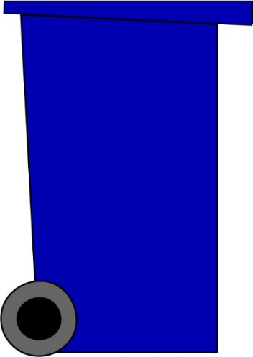

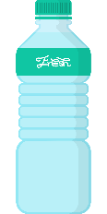
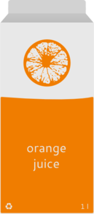
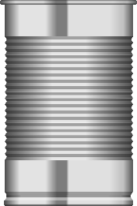
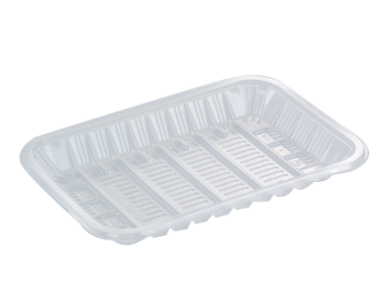
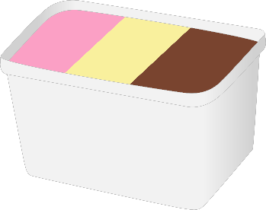
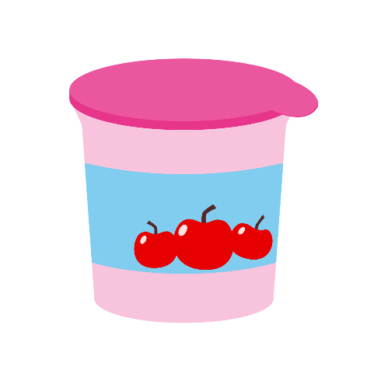
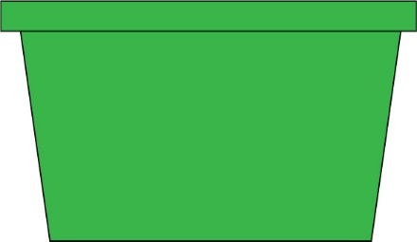
In Doncaster, we have 3 bins & 1 box
The blue bin
Cardboard
Cans
Aerosols
Envelopes
Plastic bottles
Newspapers
Cartons
Tins
Plastic tubs
Plastic pots
Plastic trays
Notes:
In Doncaster we have 3 bins and 1 box for our rubbish and recycling.
The blue bin is for most of our recycling including:
Cardboard
Newspapers
Envelopes
Cans
Tins
Plastic bottles
Cartons
Aerosols
Plastic pots
Plastic trays
Plastic tubs
*please note this is an animation and needs to viewed in presentation mode in order to work*

Slide 14

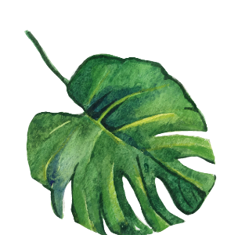

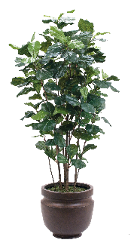

In Doncaster, we have 3 bins & 1 box
The green bin
Leaves
Flowers
Twigs
Plants
Grass cuttings
Notes:
The brown bin is for garden waste
*please note this is an animation and needs to viewed in presentation mode in order to work*

Slide 15

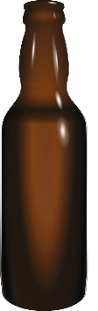
In Doncaster, we have 3 bins & 1 box
The green box
Glass jars
Glass bottles
Notes:
The green box is for glass jars and bottles
*please note this is an animation and needs to viewed in presentation mode in order to work*

Slide 16
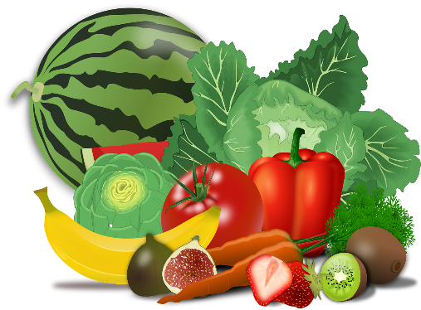
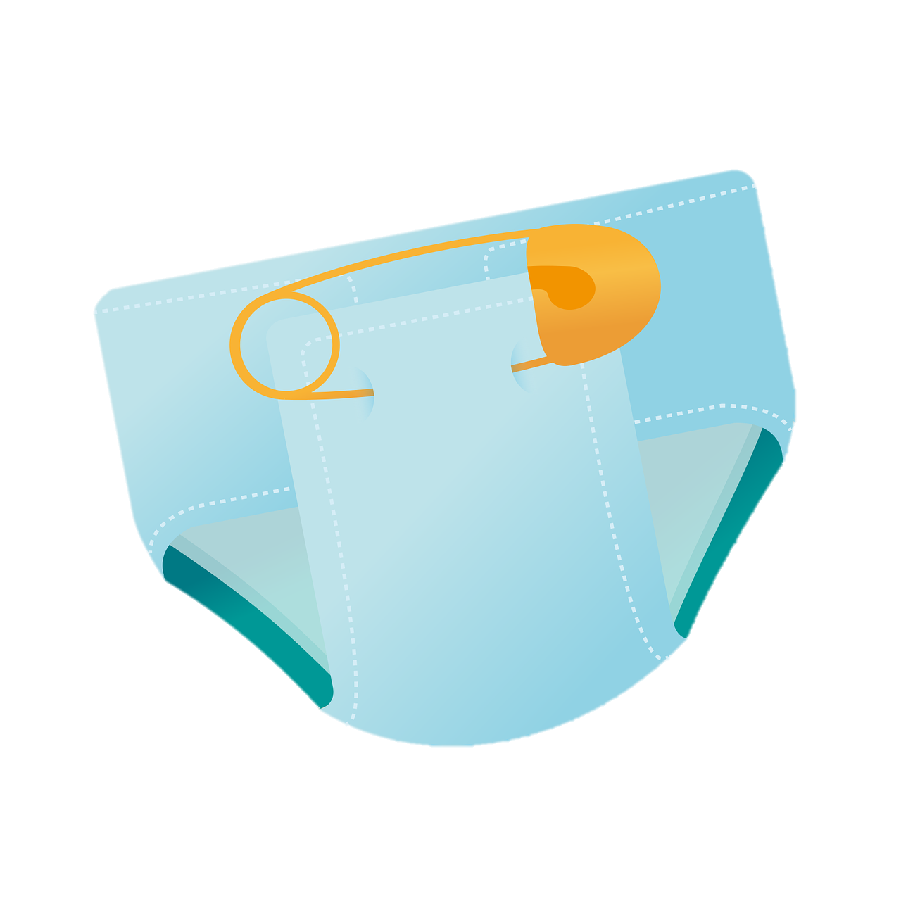
In Doncaster, we have 3 bins & 1 box
The black bin
Food waste
Nappies
Notes:
The black bin is for our general waste (stuff we cant recycle at home)
This includes nappies and food waste.
*please note this is an animation and needs to viewed in presentation mode in order to work*

Slide 17
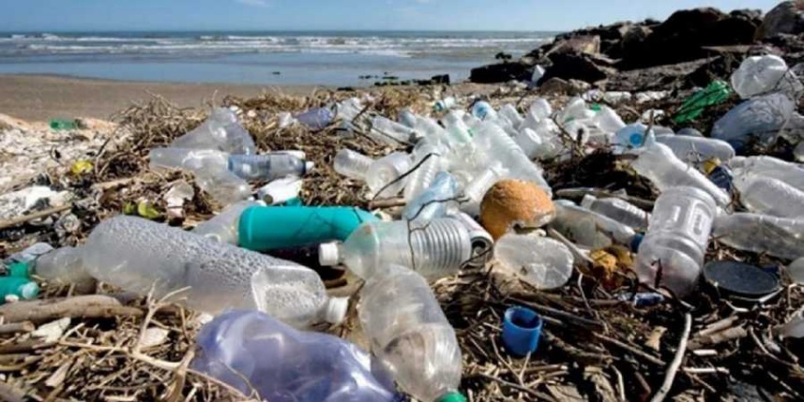
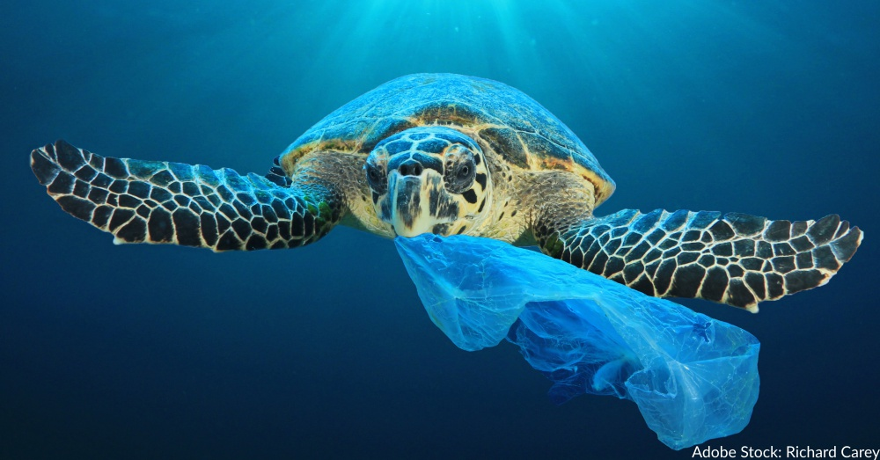
Why should we recycle?
Recycling saves our oceans and beaches!
Plastic that hasn’t been recycled may end up in the ocean.
Many animals in the ocean think that plastic is food and will eat it. This will make them very poorly!
If plastics are recycled, they won’t end up in our oceans!
Notes:
Recycling is very important because it helps keep our oceans and beaches clean.
A lot (80%) of the plastic found in the ocean comes from land based sources including litter, micro plastics and runoff.
Many sea animals mistake plastic for food. Eating too much of this will make them very poorly.
If plastics are recycled at home properly, they won’t end up in our oceans!

Slide 18
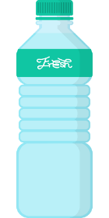
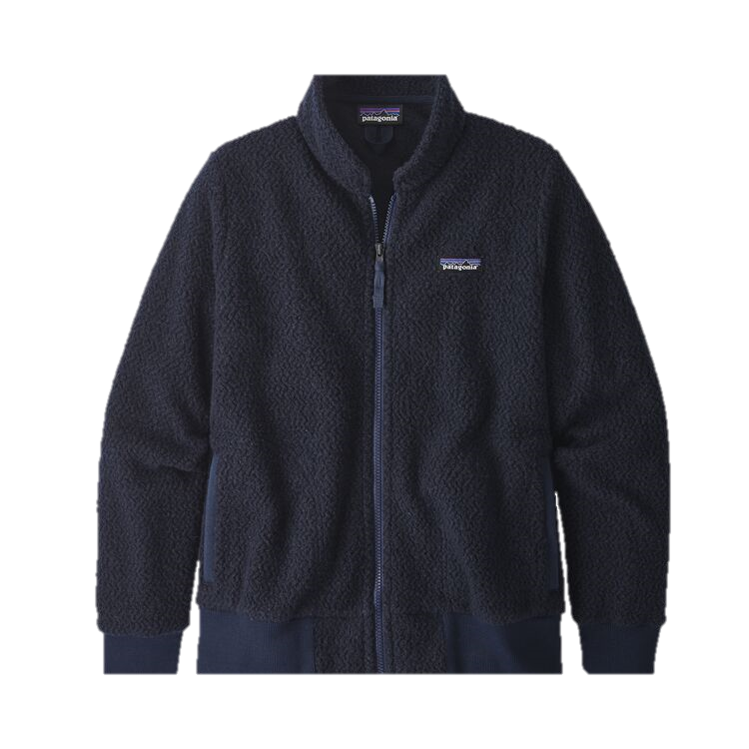
Why should we recycle?
Recycling means we can turn our waste into new things!
Notes:
25 plastic bottles can be recycled into a fleece jacket!

Slide 19
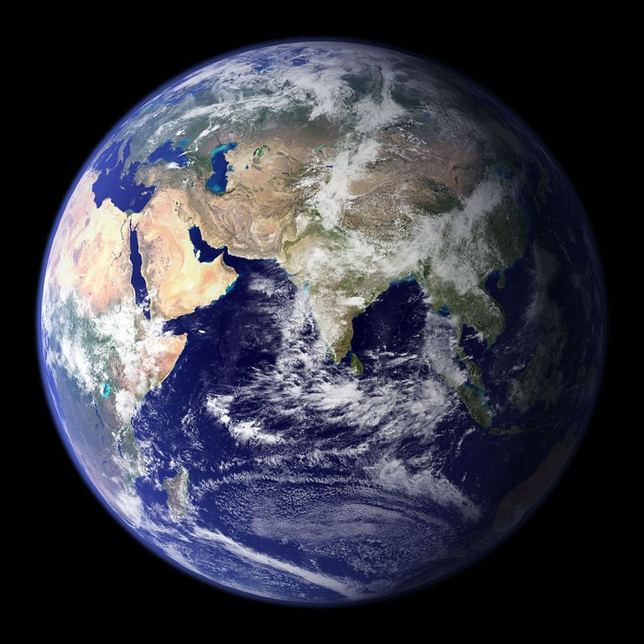
Why should we recycle?
Recycling saves our planet!
We only have one planet Earth, so it is really important that we look after it!
Notes:
Recycling means helps our planet and all the people and animals on it.
We recycle to look after our planet and help stop climate change.

Slide 20
How can you help?
Remember the 3 R’s!
Make less waste in the first place
Reduce
Reuse
Recycle
Use things again instead of throwing them away
Recycle the correct things as much as possible so that they can be made into new things
Notes:
How you can help?
Recap the 3Rs

Slide 21
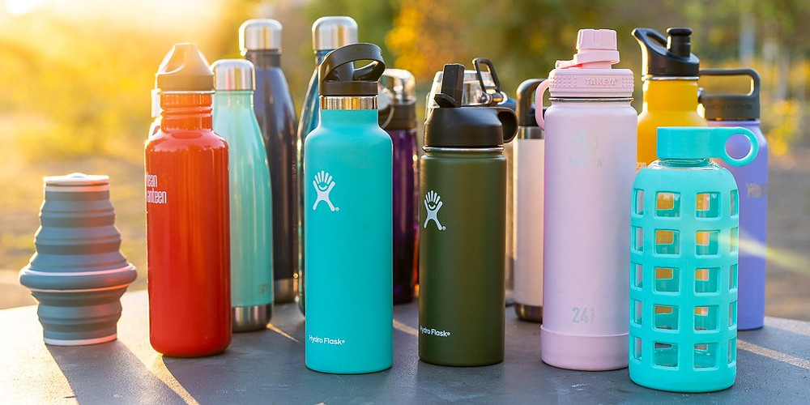
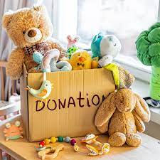
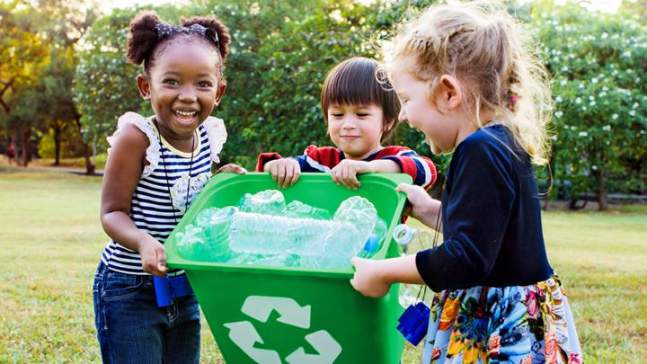
The 3Rs at home and school
Notes:
Use a refillable water bottle instead of a disposable one
Donate any of your unwanted toys or clothes to charity or give them to friends and family
Remind whoever does the shopping at home to make a list first (helps to reduce food waste) and to take their reusable bags!
Put things in the correct bin!- ask a grown up if you're not sure
Ask your class to think of other examples.

