Slide 1
Reduce, Reuse, Recycle Quiz
Let’s put your knowledge to the test!
Click here to start

Slide 2
Rules
Read the questions carefully and click on the answer you think is right
Keep your score and see how well you have done
You can do this as a class, in groups or on your own!
Good Luck!
Start

Slide 3
Q1. what are the 3R’s?
Reduce, Redesign, recycle
Reuse, Reduce, Repurpose
Reduce, Reuse, Recycle
Click on your answer!

Slide 4
Correct!
The answer is reduce, reuse, recycle!
Click here for the next question

Slide 5
Incorrect
The answer is reduce, reuse, recycle
Click here for the next question

Slide 6
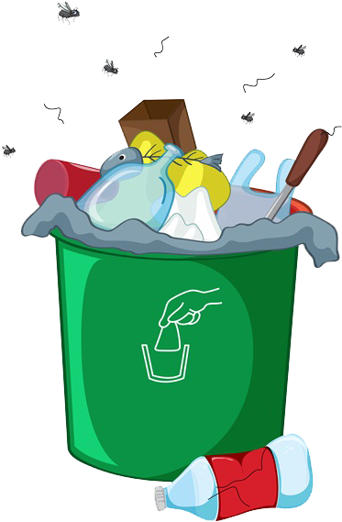
Q2. How much waste is produce in the UK every year?
3.1 million tonnes
31 million tonnes
31 billion tonnes

Slide 7
Correct!
The answer is 31 million tonnes
Click here for the next question

Slide 8
Incorrect
The answer is 31 million tonnes
Click here for the next question

Slide 9
Q3. Is the following a social, environmental or economic issue relating to waste?
‘Getting rid of the waste we make can be time consuming and expensive, especially for materials that cannot be recycled’
Social
Environmental
Economic

Slide 10
Correct!
This is an economic problem
Click here for the next question

Slide 11
Incorrect
This is an economic problem
Click here for the next question

Slide 12
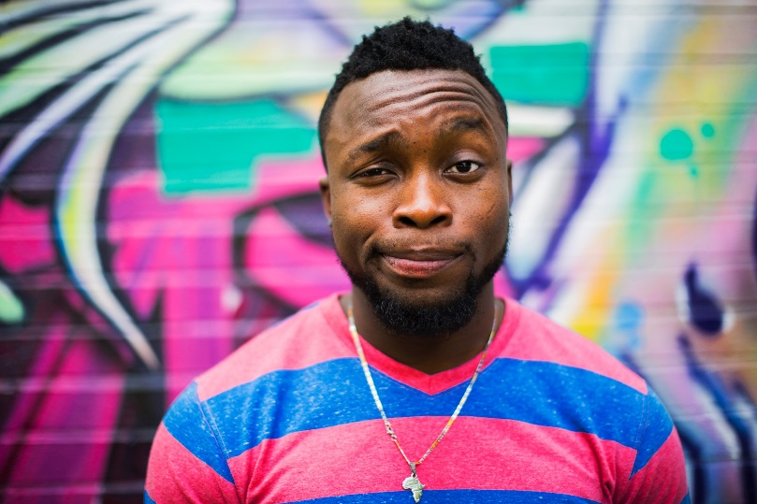
Q4. Is the following a social, environmental or economic issue relating to waste?
Plastics can trap sea birds, fish and other ocean animals
Social
Environmental
Economic

Slide 13
Correct!
This is an environmental problem
Click here for the next question

Slide 14
Incorrect
This is an environmental problem
Click here for the next question

Slide 15
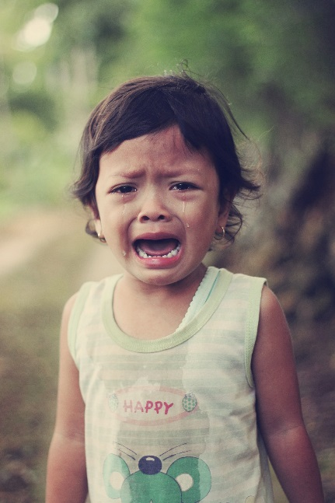
Q5. Is the following a social, environmental or economic issue relating to waste?
I don’t want to live near a landfill site
Social
Environmental
Economic

Slide 16
Correct!
This is an social problem
Click here for the next question

Slide 17
Incorrect
This is an social problem
Click here for the next question

Slide 18
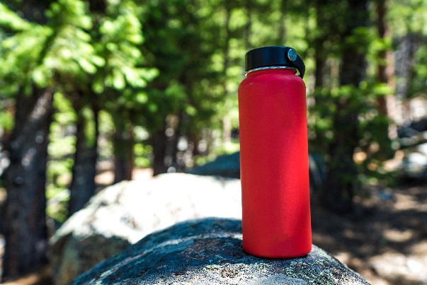
Q6. Is the following an example of reducing, reusing or recycling?
Refilling your water bottle instead of buying a new one
reducing
reusing
recycling

Slide 19
Correct!
This is an example of reusing
Click here for the next question

Slide 20
Incorrect
This is an example of reusing
Click here for the next question

Slide 21
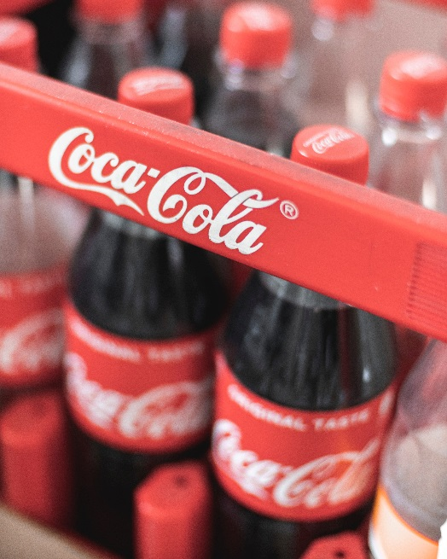
Q7. Is the following an example of reducing, reusing or recycling?
Buying a 2 litre bottle of cola instead of 4 500ml bottles
reducing
reusing
recycling

Slide 22
Correct!
This is an example of reducing
Click here for the next question

Slide 23
Incorrect
This is an example of reducing
Click here for the next question

Slide 24
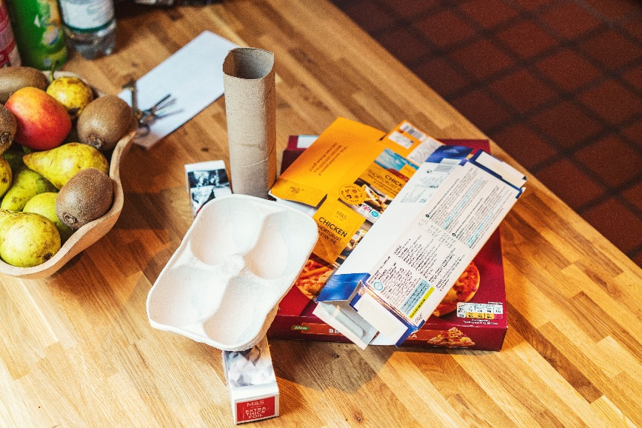
Q8. Is the following an example of reducing, reusing or recycling?
Flattening cardboard boxes and separating them from other waste
reducing
reusing
recycling

Slide 25
Correct!
This is an example of recycling
Click here for the next question

Slide 26
Incorrect
This is an example of recycling
Click here for the next question

Slide 27
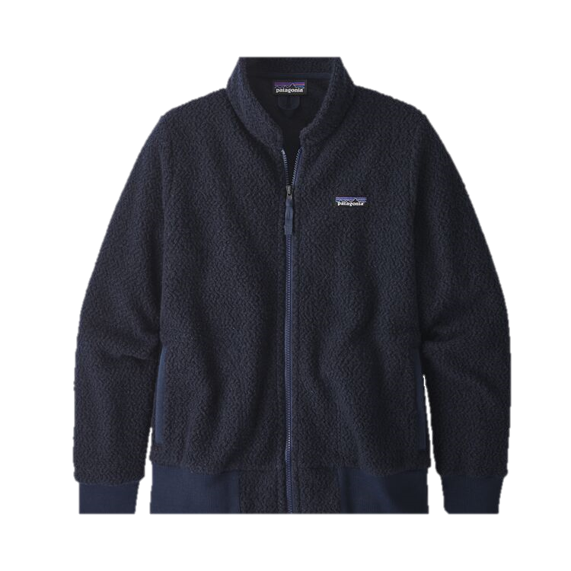
Q10. How many plastic bottles do you need to recycle to make a fleece
10
25
100

Slide 28
Correct!
The answer is 25 plastic bottles
Click here for the next question

Slide 29
Incorrect
The answer is 25 plastic bottles
Click here for the next question

Slide 30
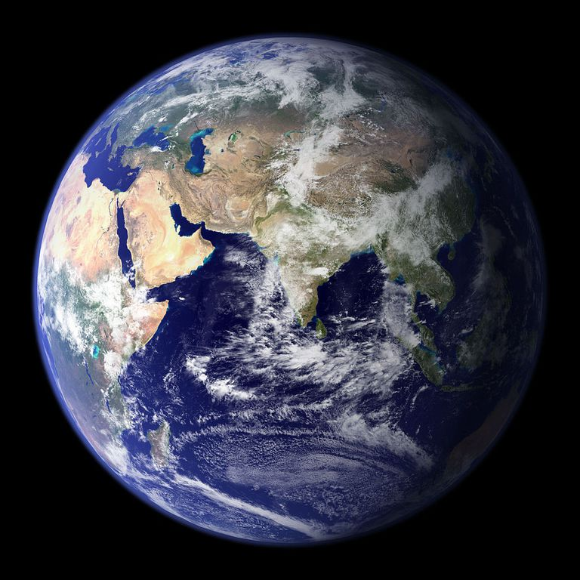
Q11. How many planets would we need to support our resource use if the entire earth used as much as the UK?
1
1.5
2.4

Slide 31
Correct!
We would need 2.4 Earths to support us!
Finish Quiz

Slide 32
Incorrect
We would need 2.4 Earths to support us!
Finish quiz

Slide 33
How did you do?

