Slide 1
Reduce, Reuse, Recycle
The 3Rs
Notes:
This presentation specifically goes through the waste and recycling in Rotherham. For Barnsley and Doncaster, please check out our website www.BDRonline.co.uk.

Slide 2
What is Waste?
Junk
Litter
Garbage
Rubbish
Trash
Notes:
Ask your class the question ‘what is waste?’
We may call it other words like the ones on screen but they all mean the same thing.
Can they give a definition of this word?

Slide 3
What is Waste?
Something that is no longer useful to us in its current form
Notes:
Waste can be anything we no longer want or need.
This could be because:
We have finished using it
It is broken
It is no longer needed by us
We don’t like it anymore

Slide 4
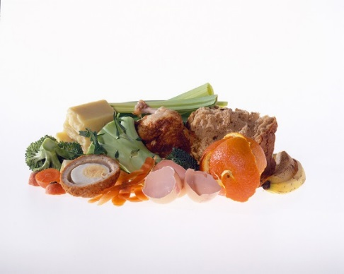
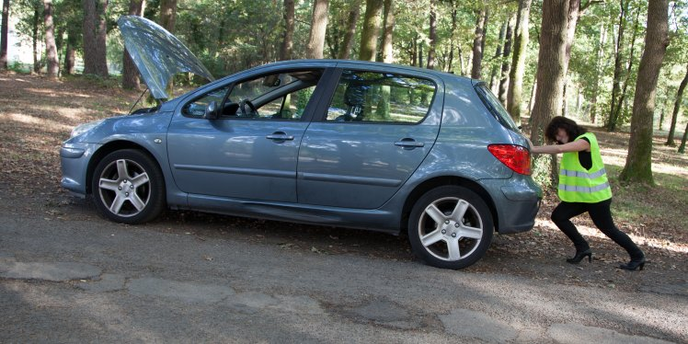
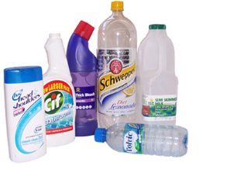
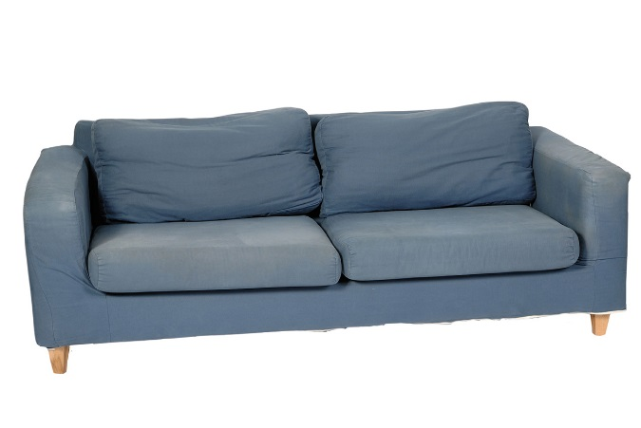
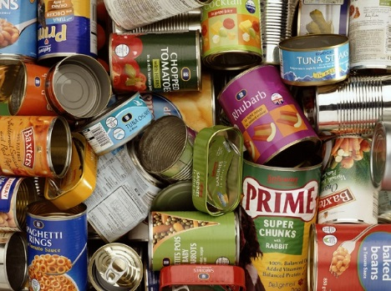
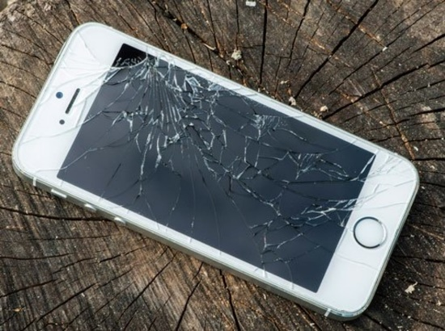
What is waste?
Can you think of any examples of waste?
Notes:
Ask your students if they can think of any things they would call waste?
This is to demonstrate that waste can be ANYTHING! It could be something as small as an eggshell after we have cooked at home or something as big as a sofa we no longer want because it is no longer our favourite colour.

Slide 5
In the UK, households produce
31 MILLION TONNES of waste a year!

Slide 6
31 million tonnes
=
3.5 million Double decker buses!
Notes:
The weight of this weight is equivalent to 3.5 million double decker buses.
If these buses were to form a queue, it would go around the entire world 2.5 times

Slide 7
Why is waste a problem?
Discuss this amongst yourselves for 2 minutes
Think about:
Social problems caused by waste
Environmental problems caused by waste
Economic problems caused by waste
Notes:
Why is waste a problem?
Waste can cause many problems for our society.
Ask your students what they think these may be.

Slide 8

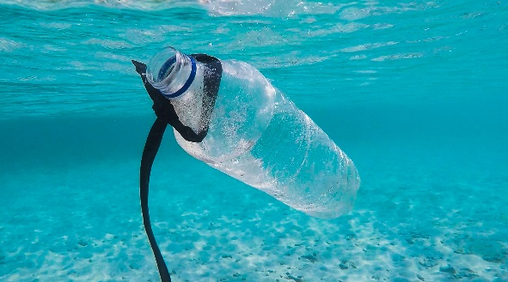
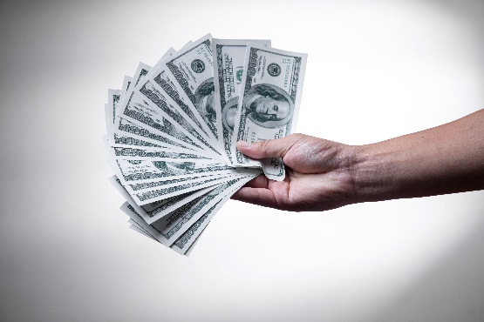
Why is waste a problem?
Social
Accumulation of waste and improper disposal can lead to health problems
Waste can take up a lot of space, leaving less space for building housing, parks and farms.
Environmental
Waste in our environment can damage habitats, harm animals and enter food chains.
Some materials take a long time to break down and they will accumulate in the environment
Economic
Disposing of waste can be expensive especially for some materials that are hard to recycle
Living near landfill sites can lower the value of properties
Waste sent to landfill is subject to tax
Notes:
Some examples of the issues caused by waste.

Slide 9
The 3R’s
Reduce
Reuse
Recycle
Make less waste in the first place
Use things again instead of throwing them away
Recycle the correct things as much as possible so that they can be made into new things
9
Notes:
To help stop the problems caused by waste, we use the 3Rs.
This means
Reduce – making less waste in the first place. This is the thing we should try to do first.
Reuse - using things again and again instead of putting them in the bin.
Recycle – putting things in the correct bin so that they can be made into new things.

Slide 10
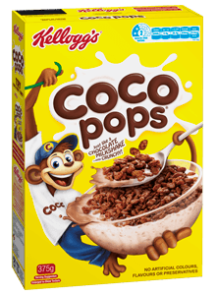
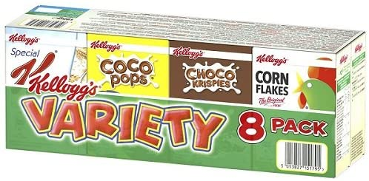
Examples of the 3Rs
Reduce
Think before you buy and only buy things that you need
Redesigning items so that they use fewer resources to make them
Think about the packaging before you buy
8 servings
Which will make more waste?
24 servings
8 Cardboard boxes
1 Cardboard box
8 inside bags
1 inside bag
No plastic film
All wrapped in plastic film
£4.00 or 16p a serving
£2.30 or 29p a serving
Notes:
Reducing means using less and buying less so that we don’t make waste
This could be by thinking before you buy and only buy what you need.
Manufacturers and companies redesigning items so that they use fewer resources and can be repaired
Or look at the packaging on items and picking the one with the least amount of packaging.
We use this cereal example to show that buying the bigger box, even though it is larger, is better than buying the variety pack as it creates less packaging overall. It also works out cheaper per serving too!

Slide 11
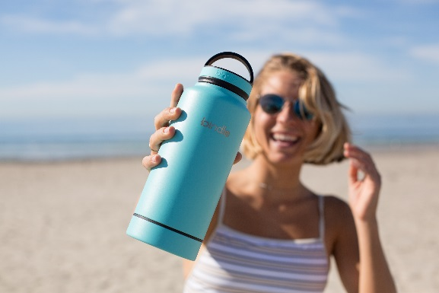
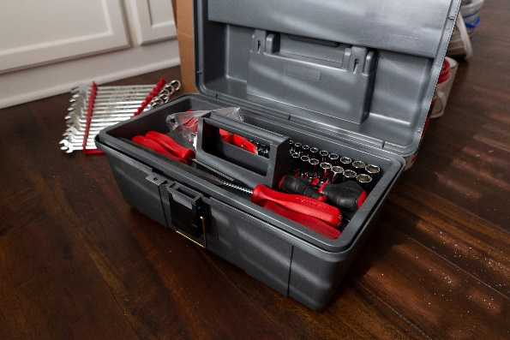
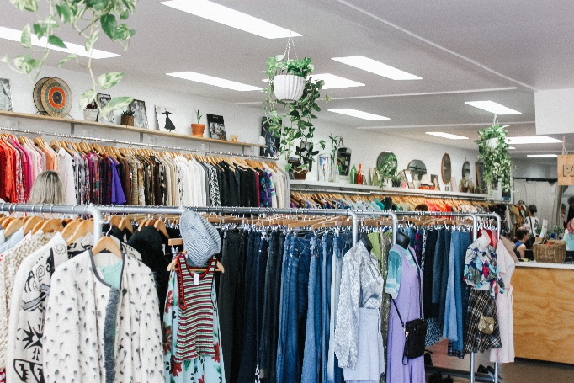
Examples of the 3Rs
Reuse
Using reusable items instead of disposable ones (e.g. water bottles and shopping bags)
Repairing broken items instead of throwing them away (e.g. replacing a broken phone screen instead of getting a new phone)
Buying second hand rather than new (e.g. furniture, toys and clothes )

Slide 12
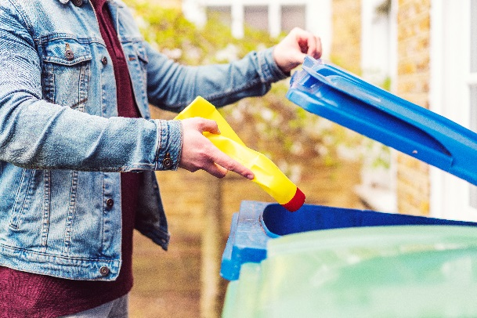
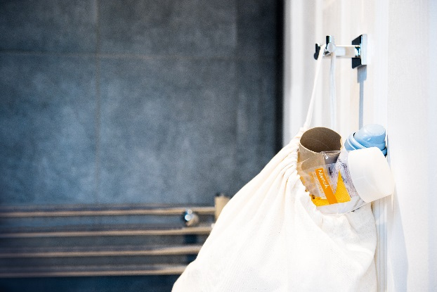
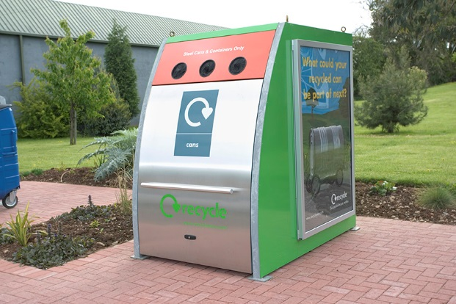
Examples of the 3Rs
Recycling
Putting the correct items in the correct bins at home (and, if possible, at school)
Keeping a recycling bin in your bedroom or bathroom
Taking your recycling to the recycling centre or bring bank
Raise your hand if you recycle at home
Notes:
Recycling means turning old things into new things.
Putting stuff in the recycling bin at home
Keeping a recycling bin in your bedroom or bathroom
Taking your recycling to the recycling centre or bring bank
Ask your class to raise their hand if they recycle at home.

Slide 13




Recycling rates in South Yorkshire
Barnsley: 44.6%
Doncaster: 43.6%
Rotherham: 44.5%
Sheffield:
32%
*Data from 2022/23
Notes:
In BDR we do average in recycling our waste. These are the percentages of waste recycled in each authority from 2022/23.
Highest ranked (1st)is South Oxfordshire District Council at 61.6%
Lowest ranked (343rd ) is Tower Hamlets at 17.7%
Barnsley is 117th at 44.6%
Doncaster is 133rd at 43.6%
Rotherham is 122nd at 44.5%
Sheffield is 227th at 32%

Slide 14
To help bin-workers, we sort our waste into different colour bins

Slide 15





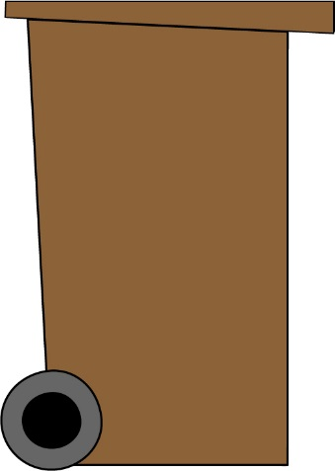

In Rotherham, we have 3 or 4 bins
The Green bin
Envelopes
Newspapers
Cardboard
Notes:
In Rotherham we have 3 or 4 bins – this depends on your household/ paid garden waste service
The green bin is for our paper and cardboard
*please note this is an animation and needs to viewed in presentation mode in order to work*

Slide 16
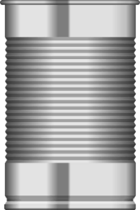

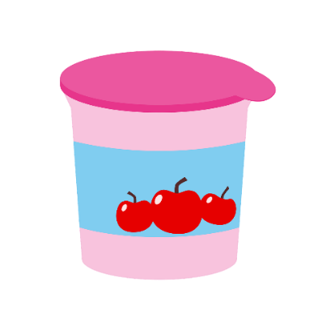
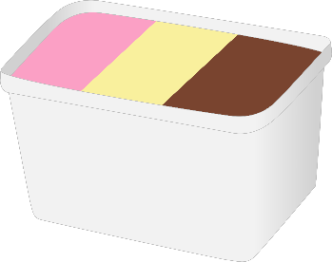
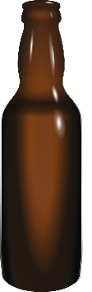


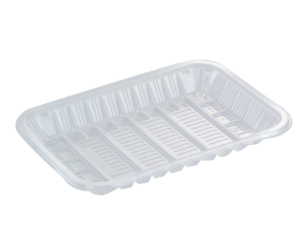
In Rotherham, we have 3 or 4 bins
The black bin
Plastic
Bottles
Plastic pots
Tins
Cans
Plastic tubs
Glass jars
Glass bottles
Plastic trays
Notes:
The black bin is for our mixed recycling
This includes:
Plastic bottles – pop bottles, shampoo bottles, water bottles
Plastic pots – yoghurt pots, cream pots
Plastic tubs- ice cream tubs, butter tubs
Plastic trays- fruit trays, meat trays
Tins – beans, tuna, sweetcorn
Cans – pop cans
Glass bottles- pop glass bottles
Glass jars – jam jars, sauce jars
*please note this is an animation and needs to viewed in presentation mode in order to work*

Slide 17



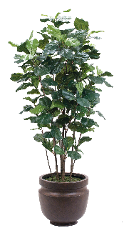

In Rotherham, we have 3 or 4 bins
The brown bin
Leaves
Flowers
Leaves
Plants
Grass cuttings
Notes:
The brown bin is for garden waste
Not everyone will have this bin as not everyone wants/needs one and it is a paid service.
*please note this is an animation and needs to viewed in presentation mode in order to work*

Slide 18


In Rotherham, we have 3 or 4 bins
The pink lid bin
Nappies
Food waste
Notes:
The pink lid bin is for the things we cannot recycle at home
This could be nappies, soft plastic packaging and food waste.
*please note this is an animation and needs to viewed in presentation mode in order to work*

Slide 19

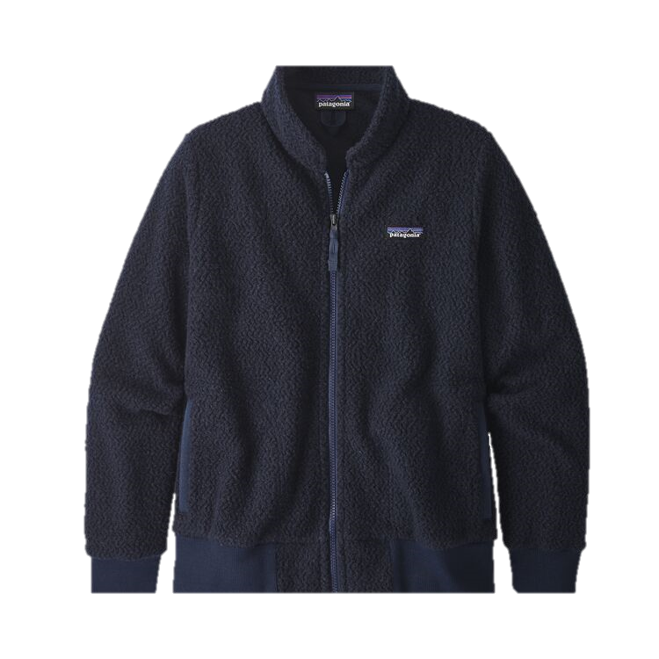
Why should we recycle?
Recycling means we can turn our waste into new things!
Notes:
Recycling means we can turn our waste into new things.
We can make one fleece jacket by recycling 25 plastic bottles.

Slide 20
Why should we recycle
Recycling saves our resources
Many of the resources we use are finite meaning that they take a long time to replenish and therefore can be very limited.
The more materials and products we make, the quicker our resources get used.
It is important to recycle so that we can keep our resources useful for longer
Resources
‘Stuff’ we make
Notes:
Recycling helps us manage and save our resources.
Plastics comes from oil
Paper comes from trees/wood
Metals comes from ores
Energy used our items can come from fossil fuels.

Slide 21

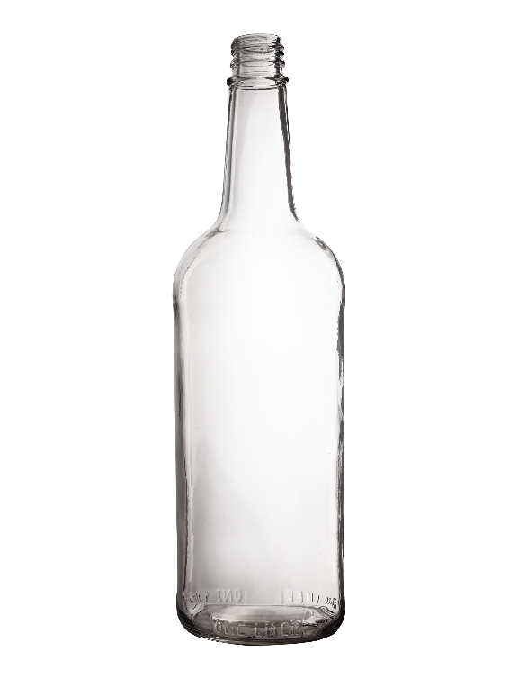
Why should we recycle?
Recycling saves energy!
By recycling just one glass bottle, enough energy is saved to power a light bulb for four hours.
Notes:
Using recycled materials saves energy compared to the energy needed to extract, process and transport new virgin materials.

Slide 22
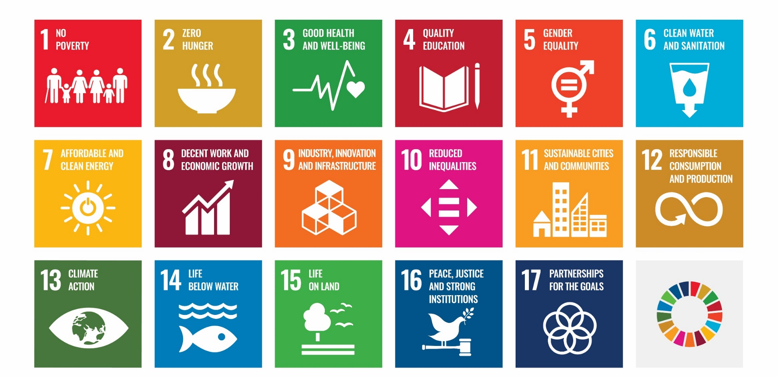
Why should we recycle?
Becoming more sustainable
By recycling at home, we are helping to achieve these goals!
Notes:
The United Nations Sustainable Development Goals
Sustainability effects all aspects of our lives. The sustainable development goals (SDGs) are a set of targets created by the United Nations in 2015. They relate to future international development with the aim of solving social, environmental, and economic issues that society faces.
Recycling our waste helps contribute to achieving these goals.

Slide 23
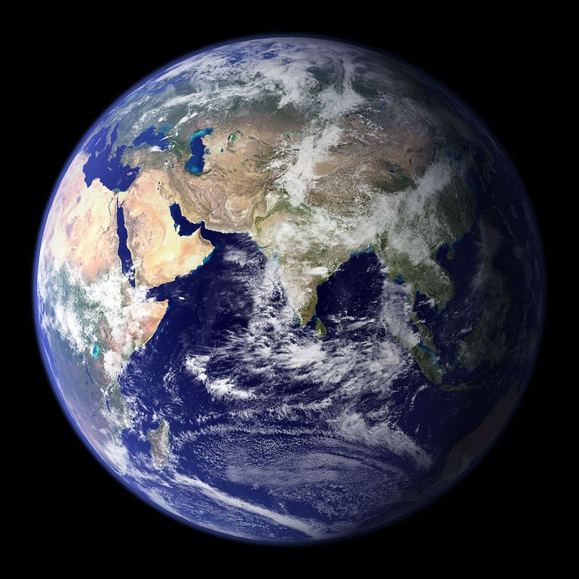
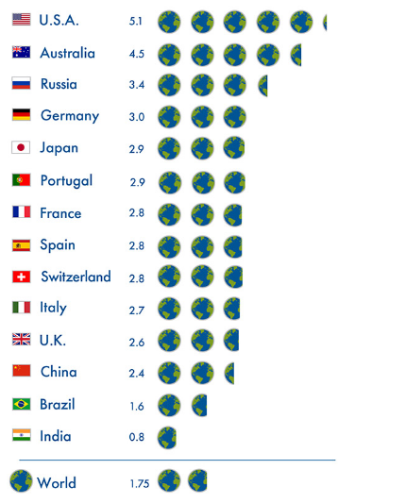
Why should we recycle?
How many Earths would we need?
Recycling saves our planet
If the entire planet used resources at the rate the UK does, we would need 2.6 Earths to support us.
We only have one planet Earth, so it is really important that we look after it!
Notes:
Recycling saves our planet!
If the entire planet consumed resources at the rate the UK does, we would need 2.6 planets to sustain us.
Humanity as a whole is using nature 1.7 times faster than our planet’s biocapacity can regenerate. That’s equivalent to using the resources of 1.7 Earths.

Slide 24
How can you help?
Remember the 3 R’s!
Make less waste in the first place
Reduce
Reuse
Recycle
Use things again instead of throwing them away
Recycle the correct things as much as possible so that they can be made into new things

Slide 25
The 3Rs at home and school
Shop smartly and think about the waste created by the packaging
Use a refillable water bottle rather than a disposable one
Donate any of your unwanted clothes to charity or give them to friends and family
Use rechargeable batteries
Have a recycling bin your bathroom and bedroom so that you don’t forget anything!
Put things in the correct recycling bin based on the advice from you Council- not the packaging/symbols!
Notes:
Ask your students if they have any suggestions on how the could reduce, reuse and recycle to help the planet.
A quiz on the learnings of this lesson can be found at https://www.bdronline.co.uk/education/key-stage-34-resources/1

