Slide 1
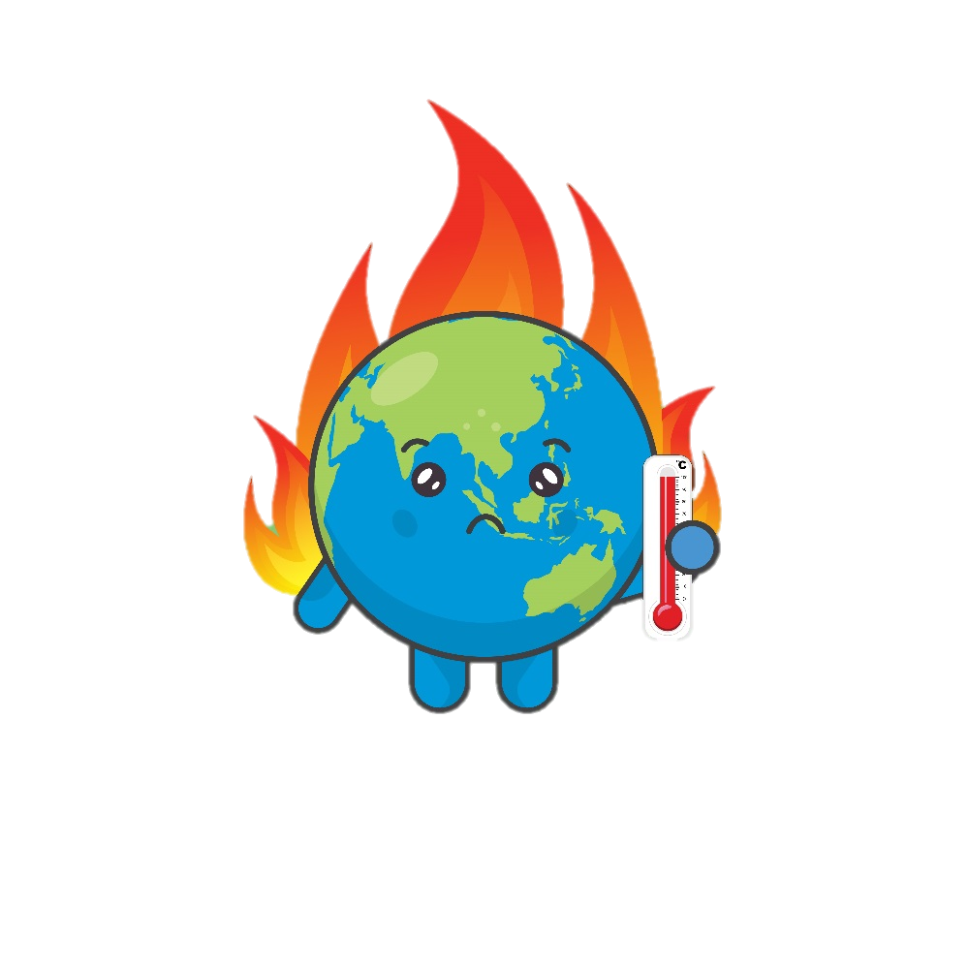
What is Climate Change?

Slide 2
Aims and objectives
To understand the importance of climate change
Success criteria
I can describe what climate change is
I can identify the causes of climate change
I can explain how to prevent climate change

Slide 3
Our planet
What is this a photograph of?
It has everything we need to survive.
Can you think what those things might be?
This is Earth.
This is our planet.
Oxygen (or Air)
Food
Water
Shelter
Warmth
It is about 4 and a ½ billion years old!

Slide 4
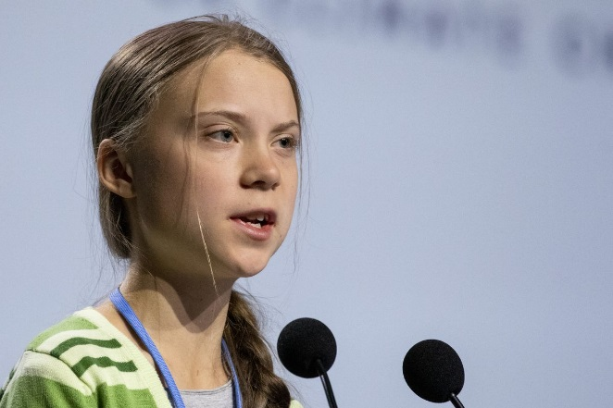
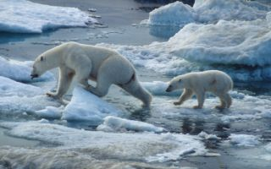
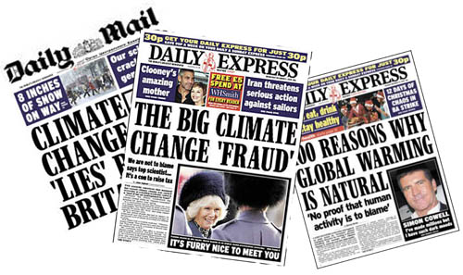
Our planet is changing…
Climate change has been in the news a lot.
Raise your hand if you have heard of it
What do you think it means?

Slide 5
What is climate change?
Climate change is the name given to changes in weather and temperature
These changes are a result of human activity and can cause a lot of problems for our planet
1913
2012

Slide 6
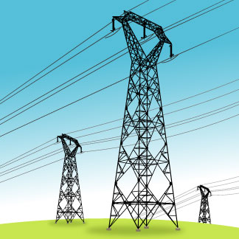
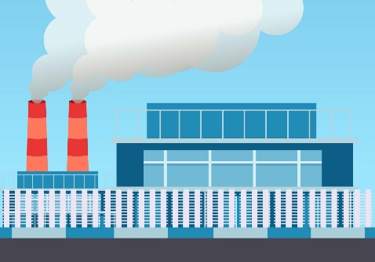
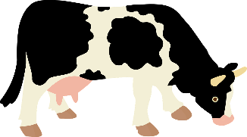
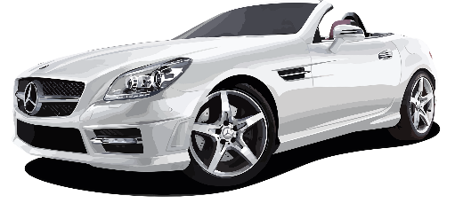
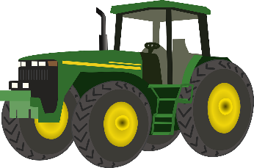
Why is the climate changing?
The human population (number of people on our planet) is increasing very fast because we live longer, have better healthcare and have more children.
This has led to the increase of gases being released into our atmosphere that have caused rising temperatures all over the world.
Examples of what has caused our climate to change:
Burning fossil fuels to make electricity
Manufacturing goods
Farming
Transportation

Slide 7
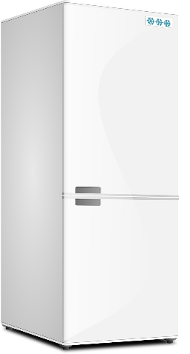
Climate change gasses
We call these gases greenhouse gases because, just like a greenhouse, they trap heat inside the Earth's atmosphere
Hydrofluorocarbons (HCFCs)
Used in fridge freezers and air conditioning units.
Water Vapour (H₂O)
This is created through the heating of water. We commonly call this steam.
Carbon Dioxide (CO₂)
When fossil fuels such as coal, oil and gas are burned, they release carbon dioxide.
Nitrous oxide (N₂O)
Commonly known as ‘laughing gas’. This gas is released through the burning of fossil fuels and other industrial activities
Methane (CH₄)
Digestive gas released by animals such as cows and pigs and through melting permafrost.

Slide 8
The Greenhouse effect
Sun
Some of the heat reflects back into space
Space
Heat from the sun
Cloud
Greenhouse gases
Atmosphere
The Sun’s rays warm the Earth
Greenhouse gases trap some of the heat in the atmosphere which heats up the planet
Earth
Earth

Slide 9
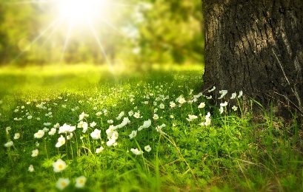
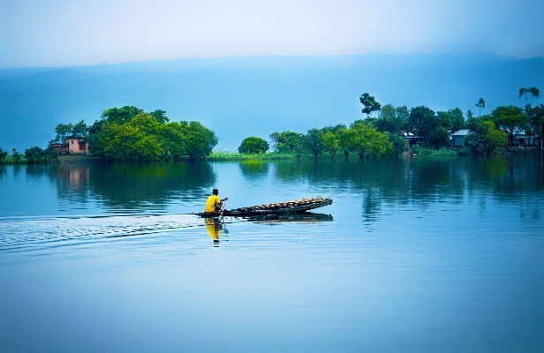
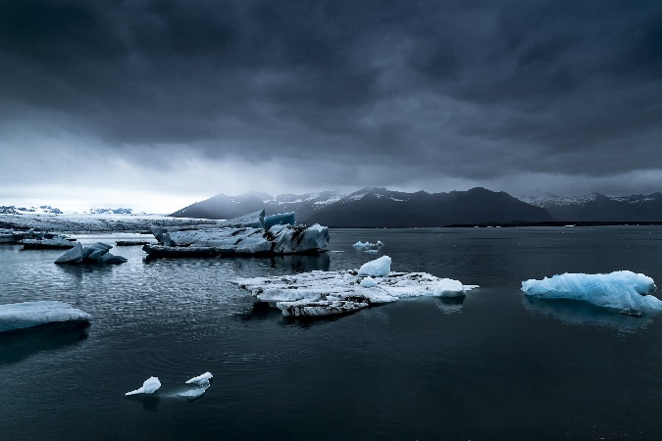
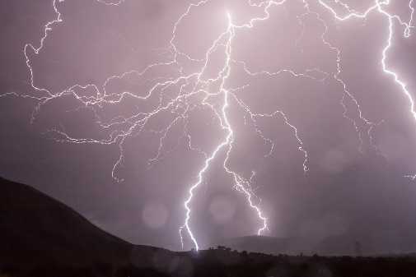
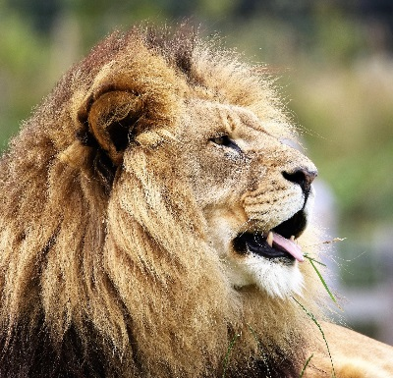
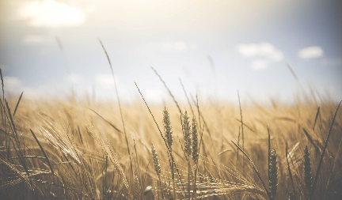
What is happening because of climate change
Because the climate is getting hotter, it can have a huge effect on the planet. Some examples include:
More extreme weather all around the world
Animal and plant species becoming extinct
Shrinking glaciers
Trees and plants flowering much earlier
Changes to where we can grow crops and how much food we can produce
Rising sea level

Slide 10
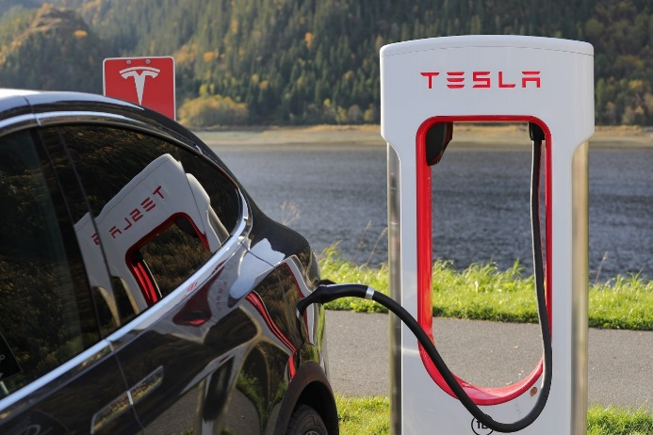
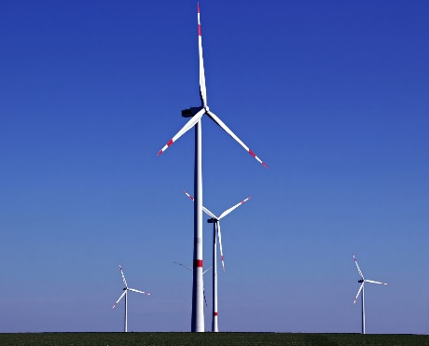
What is being done to reduce climate change?
The leaders of many countries around the world have begun to tackle climate change by changing laws to reduce the amount of greenhouse gases being released into the atmosphere
Examples of what is being done:
Building more environmentally friendly cars and encouraging public transportation
Using renewable energy sources instead of fossil fuels
Being more resourceful with the materials we have

Slide 11
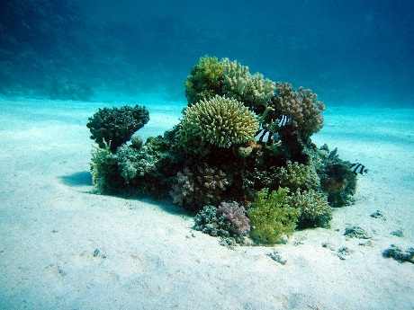
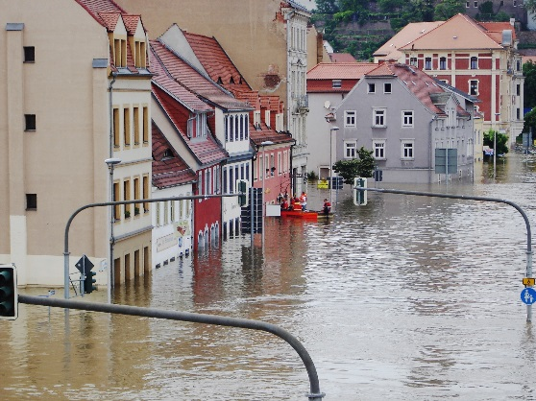
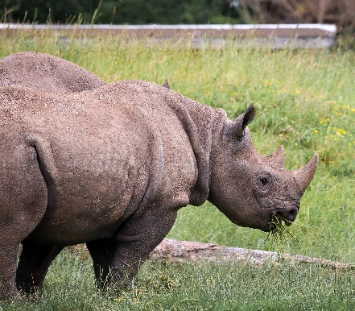
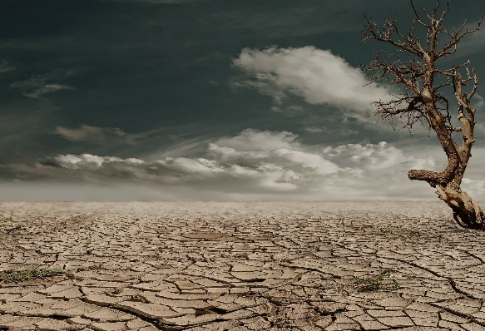
What if we don’t do anything to help stop climate change?
Scientists across the world have predicted some serious consequences for our planet if we don’t slow down climate change…
Up to 30% of Earth’s wildlife could become extinct
Droughts and storms will become more frequent. This makes it difficult to grow crops and food.
90% of coral reefs can become lifeless due to the ocean water being too warm
Low-lying land and habitats can become flooded

Slide 12
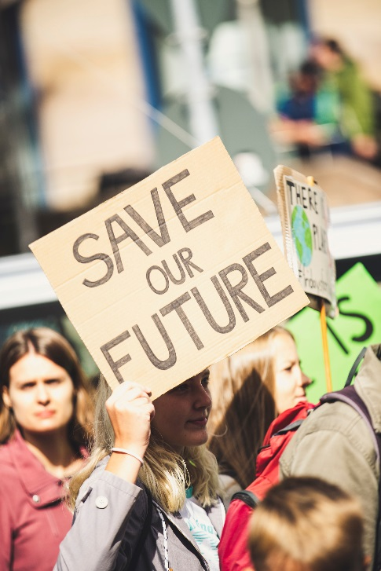
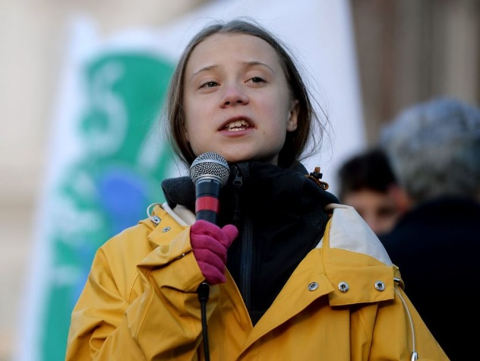
The Climate protests
Young people (just like you!) all over the world are very unhappy about climate change and are starting to do something about it!
They have written letters to important people, such as politicians and the Prime Minister, asking them to help the planet
In February 2019, lots of young people did not go to school or college. They wanted to show the grown-ups that they know how serious climate change is and that they should do something about it so attended protests.

Slide 13
What do you think?
Is enough being done in the UK and in our area to tackle climate change?
Were the children right for taking time out of school to protest?
What is your school doing to help reduce climate change?
Is enough being done across the globe to combat climate change?

Slide 14
How can YOU help?
Everyone must do their bit to save the planet. We only have one planet, so it is very important that we look after it.
Reduce, Reuse and Recycle
Reduce
Reuse
Recycle
Make less waste in the first place
Use things again instead of throwing them away
Recycle the correct things as much as possible so that they can be made into new things

Slide 15
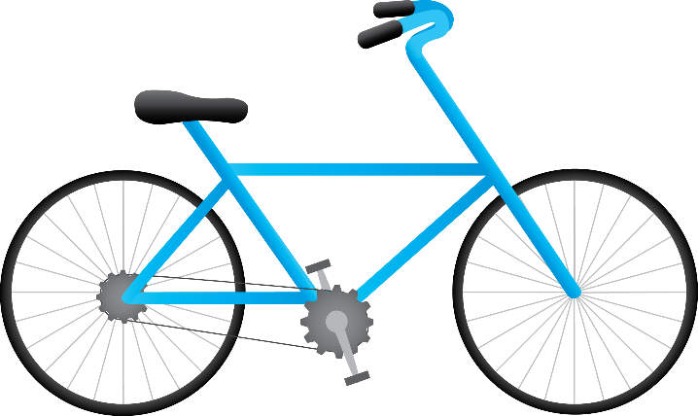
How can YOU help?
Everyone must do their bit to save the planet! We only have one planet, so it is very important that we look after it.
Use the car less
Walk or bike to school to help cut down on pollution

Slide 16
How can YOU help?
Everyone must do their bit to save the planet! We only have one planet, so it is very important that we look after it.
Save water
Have a shower instead of a bath
Turn the tap off when you're not using it

Slide 17
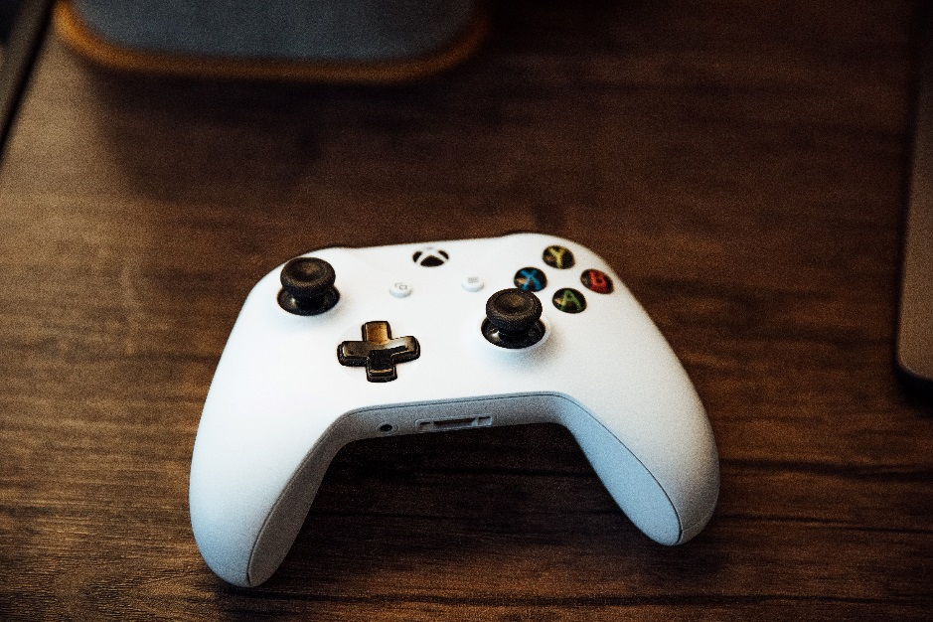
How can YOU help?
Everyone must do their bit to save the planet! We only have one planet, so it is very important that we look after it.
Save electricity
Switch off any lights, TV’s, radios, games consoles, and any other electrical items when you're not using them

Slide 18
How can YOU help?
Everyone must do their bit to save the planet! We only have one planet, so it is very important that we look after it.
Write an email or letter to your local politician
Tell them what you think about climate change and ask them what they are doing to help our planet

Slide 19
Aims and objectives
To understand the importance of climate change
Success Criteria
I can describe what climate change is
I can identify the causes of climate change
I can explain how to prevent climate change

