Slide 1

Teachers Notes- KS1
This activity compliments the presentation called ‘the 3Rs’ and will help pupils when performing the activity.
For this activity, you can adapt based on your classroom set up and needs of your learners. You can add other items to the mix of rubbish such as toy foods, artificial flowers, and any items of clean rubbish you have.
An easy way to start is by printing a set per table/group, cutting out the waste items, and giving them a time limit to see who can sort the fastest.
After the sorting task, see which group has sorted the best quality and reward them if possible
Ask them the follow up questions too:
Can you name the different types of materials collected in each bin?
Examples: paper, card, metals, plastics etc.
Can you describe the properties of the different materials in each bin?
Examples: metals (magnetic, shiny, hard) Plastics (flexible and strong) paper (flexible, tears easily)
Thinking of the 3R’s, what could you reduce or reuse before putting it in the bin?
Examples: switching to reusables bags and bottles, using jars and boxes for storage, using items for crafts
Why do you think we separate our rubbish like this?
If you are unsure about an item and where it goes, what should you do?

Slide 2
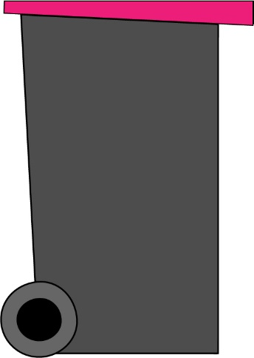
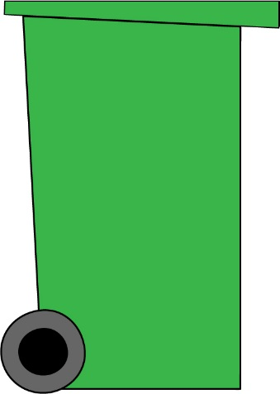
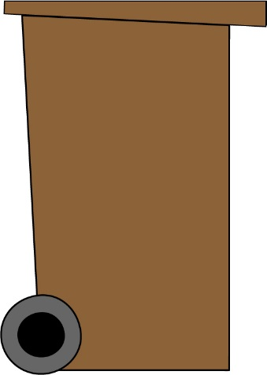
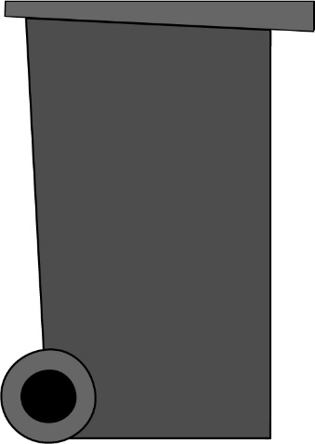
Rotherham
Pink-lid bin
Green bin
Brown bin
Black bin

Slide 3


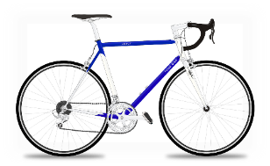
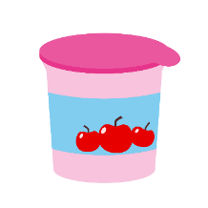



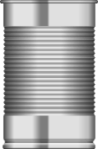
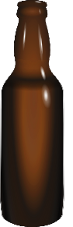






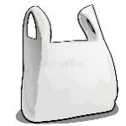

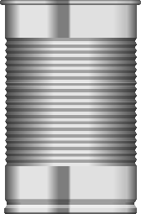
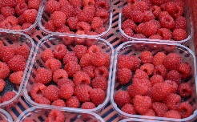

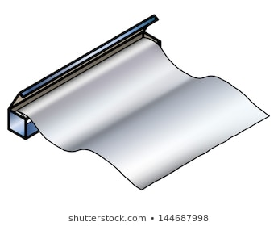

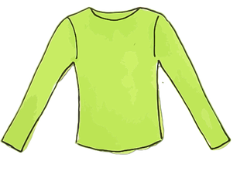
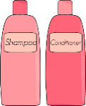
Water bottle
Jars
Yoghurt pots
Bicycle
Apple core
Drinks can
Nappies
Food tin
Glass bottle
Wrapping paper
Newspaper
Envelope
Box
Light bulb
Plastic bag
Sweet wrappers
Flowers
Grass
Tins
Plastic tray
Shampoo bottles
Tin foil
Orange peel
Clothes

