Slide 1
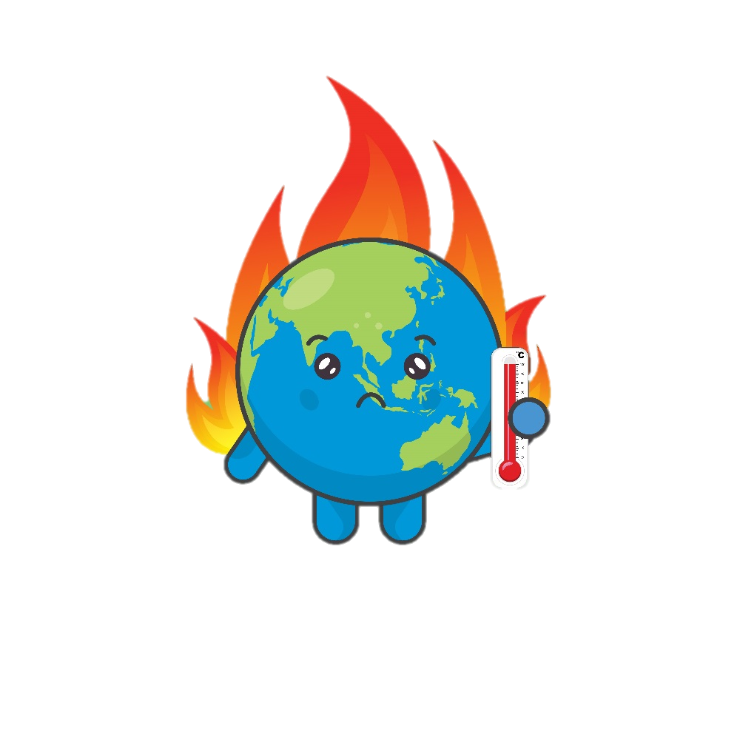
What is Climate Change?

Slide 2
Our planet
What is this a photograph of?
It has everything we need to survive.
Can you think what those might be?
This is Earth.
This is our planet.
Oxygen (or Air)
Food
Water
Shelter
Warmth
It is about 4 and a ½ billion years old!

Slide 3
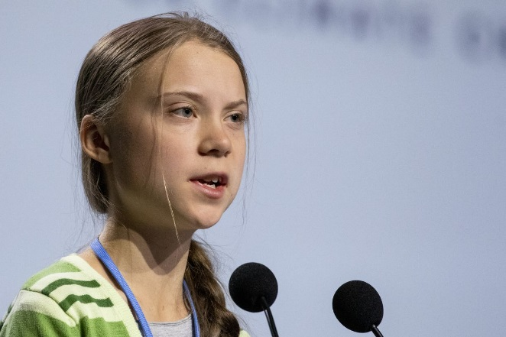
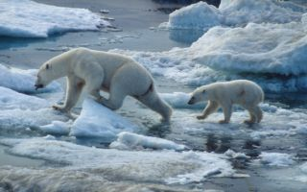
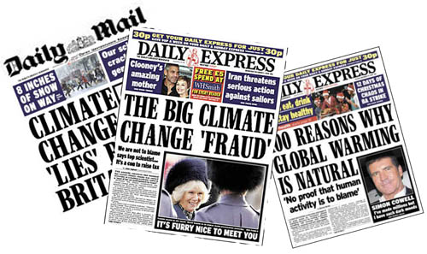
Our planet is changing…
Climate change has been in the news a lot.
Raise your hand if you have heard of it
What do you think it means?

Slide 4
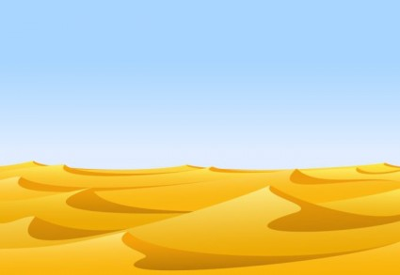
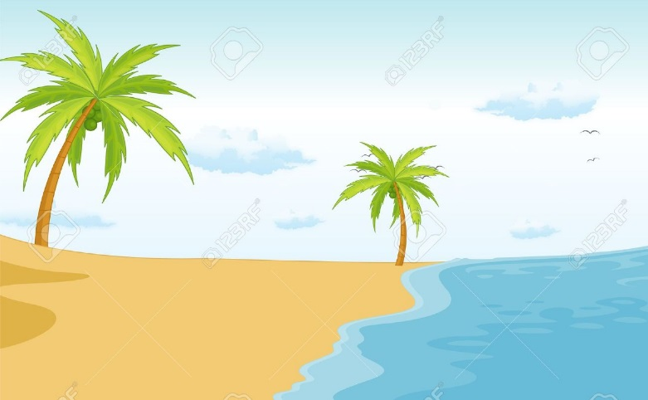
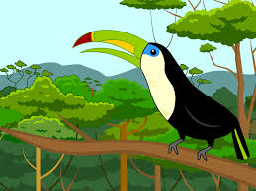
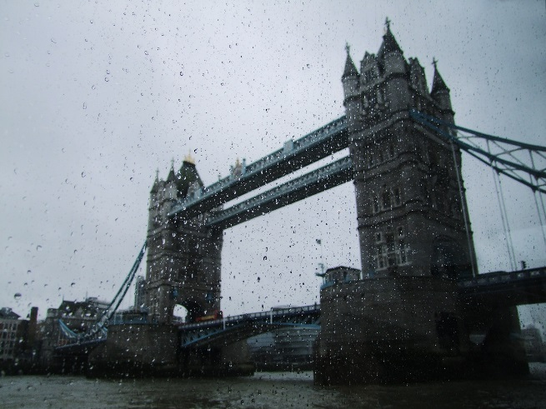
What is a climate?
Our planet has lots of different types of weather in different countries
We call these weather types climates
Here are some examples:
Rain forest= wet and hot
The North pole = cold and snowy
Desert= hot and dry
Beach =Warm and sunny
England= rainy and cold!

Slide 5
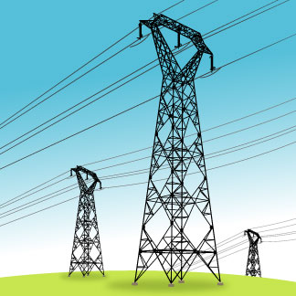
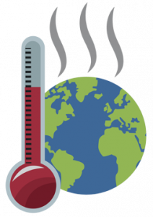
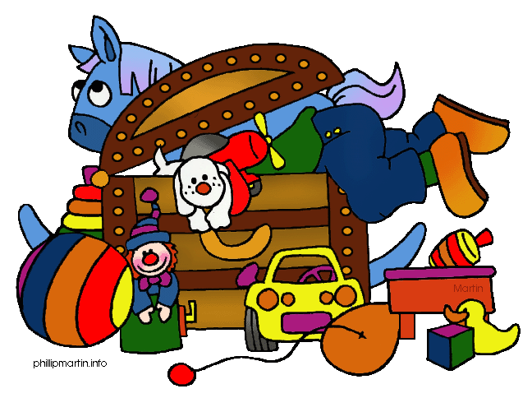
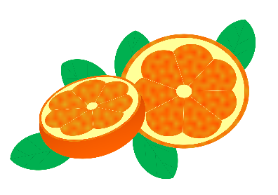
How does climates change?
Our climate is changing because the number of humans on our planet is going up
This causes harmful gases to enter our air and cause the climate to change.
Because there are more people, we need more stuff, electricity, heating and transport to look after them
When they go up into the air, they get trapped in the layer protecting the Earth from the Sun. When the Sun shines onto the Earth, the heat is kept in by the gases. This causes it to get hotter and hotter causing changes to climate all over the world.
We also need more food and land for them to use

Slide 6
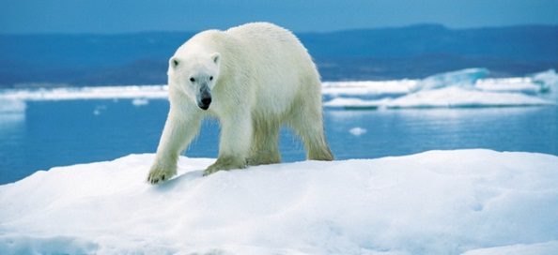
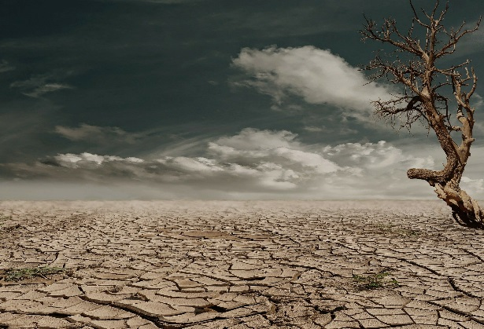
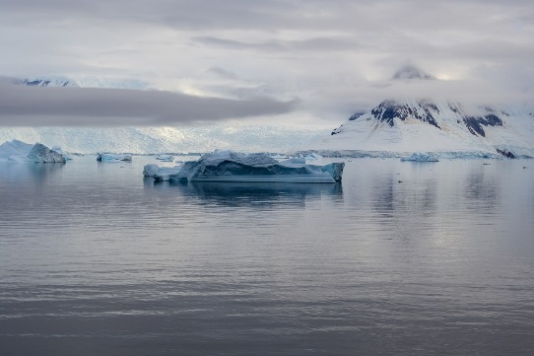
What Happens because of Climate Change?
Because our planet is getting hotter, it means that ice at the North and South poles will start to melt, causing other areas of the planet to flood
Also animals living at the North and South poles will have nowhere to live as their homes will melt
Some parts of the world will experience droughts. This means that there is low rainfall and that farmers will be unable to grow food to feed people
This means that some animals will not be able to nest on beaches- such as sea turtles and seals.

Slide 7
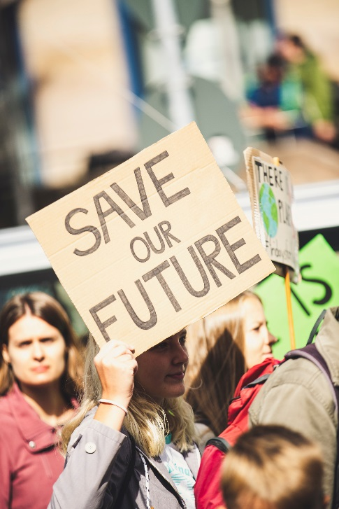
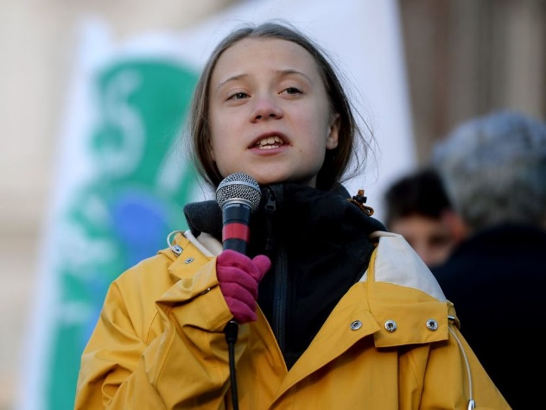
The Climate protests
Young people (just like you!) all over the world are very unhappy about climate change and are starting to do something about it!
They have written letters to important people such as politicians and the Prime Minister asking them to help the planet
In February 2019, lots of young people did not go to school or college. Instead they made posters and banners and took to the streets with their message to help the planet. This is called a protest.

Slide 8
How can YOU help?
Everyone must do their bit to save the planet. We only have one planet, so it is very important that we look after it.
Reduce, Reuse and Recycle
Reduce
Reuse
Recycle
Make less waste in the first place
Use things again rather than them throw away
Put as much correct things in the recycling bin as possible- so that they can be made into new things

Slide 9
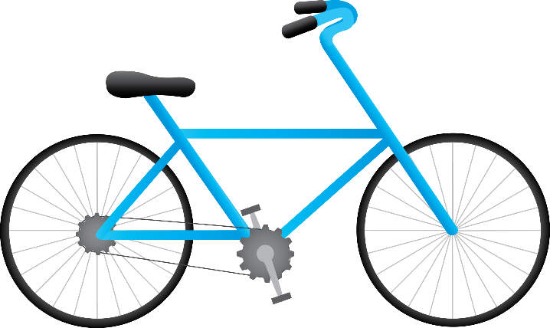
How can YOU help?
Everyone must do their bit to save the planet. We only have one planet, so it is very important that we look after it.
Use the car less
Walk or bike to school to help cut down on pollution

Slide 10
How can YOU help?
Everyone must do their bit to save the planet. We only have one planet, so it is very important that we look after it.
Save water
Have a shower instead of a bath
Turn the tap off when you are not using it

Slide 11
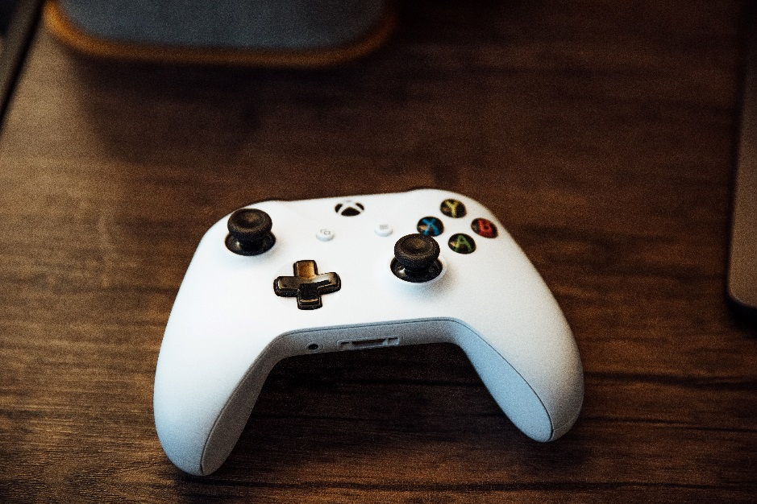
How can YOU help?
Everyone must do their bit to save the planet. We only have one planet, so it is very important that we look after it.
Save electricity
Switch off any lights, TV’s, radios, games consoles, and any other electrical items when you are not using them

Slide 12
How can YOU help?
Everyone must do their bit to save the planet. We only have one planet, so it is very important that we look after it.
Write a letter to your local politician
Tell them what you think about climate change and ask them what they are doing to help our planet

Slide 13
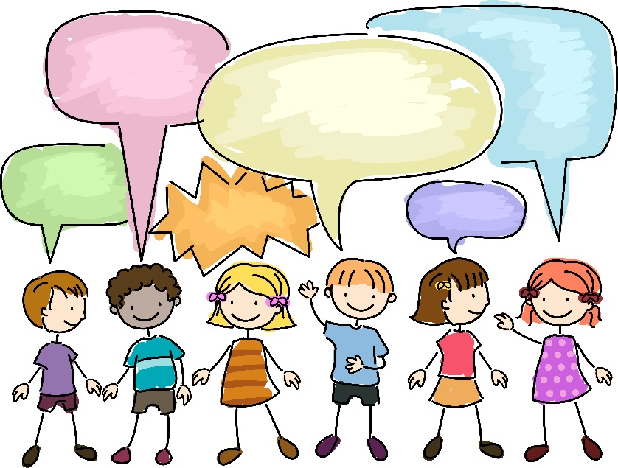
How can YOU help?
Everyone must do their bit to save the planet. We only have one planet, so it is very important that we look after it.
Tell people what you have learnt about climate change
By letting friends and family what you have learnt about climate change and why it is important, we can help stop it!

