Slide 1
Reduce, Reuse, Recycle
The 3Rs

Slide 2
What is Waste?
Junk
Litter
Garbage
Rubbish
Trash

Slide 3
What is Waste?
Something that is no longer useful to us in its current form

Slide 4
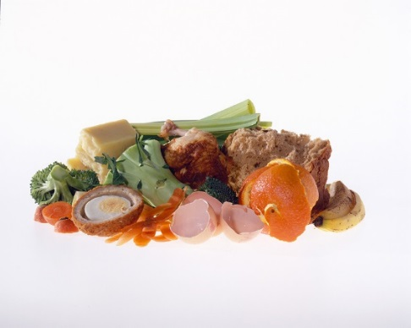
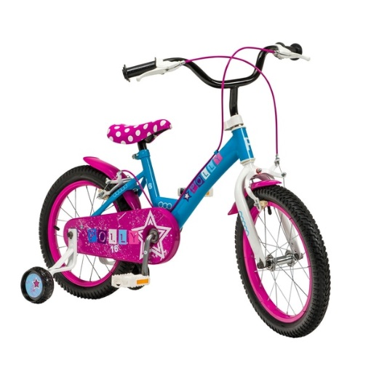
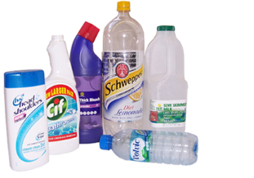
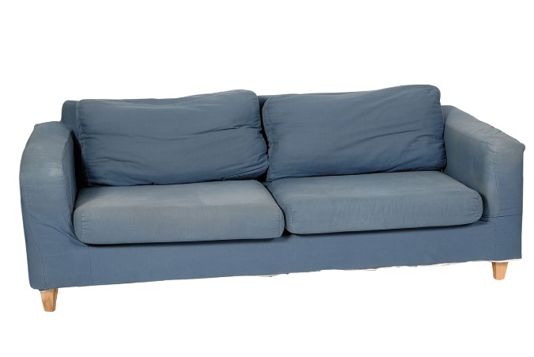
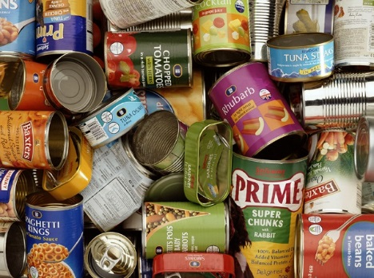
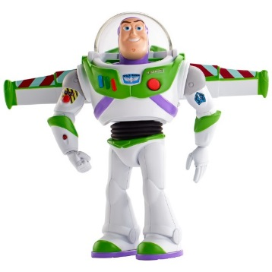
What is waste?
Can you think of any examples of waste?

Slide 5
In the UK we produce 31 MILLION TONNES of waste a year!

Slide 6
31 million tonnes
=
3.5 million Double decker buses!
Notes:
equivalent to the weight of three and a half million double-decker buses, a queue of which would go around the world two and a half times.

Slide 7
Why is waste a problem?
Discuss this amongst yourselves for 2 minutes
Think about:
Social problems caused by waste
Environmental problems caused by waste
Economic problems caused by waste

Slide 8
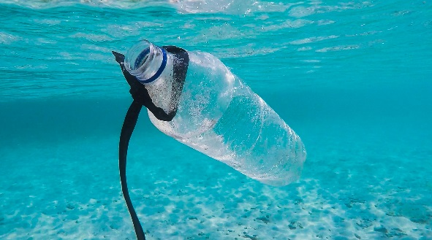
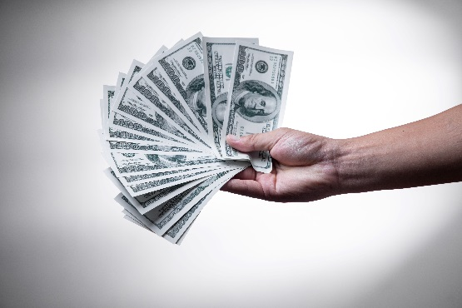
Why is waste a problem?
Social
Accumulation of waste and improper disposal can lead to health problems
Waste can take up a lot of space, leaving less space for building housing, parks and farms.
Environmental
Waste in our environment can damage habitats, harm animals and enter food chains.
Some materials take a long time to break down and they will accumulate in the environment
Economic
Disposing of waste can be expensive especially some materials that are hard to recycle
Living near landfill sites can lower the value of properties
Waste sent to landfill is subject to tax

Slide 9
The 3R’s
Reduce
Reuse
Recycle
Make less waste in the first place
Use things again instead of throwing them away
Recycle the correct things as much as possible so that they can be made into new things
9

Slide 10
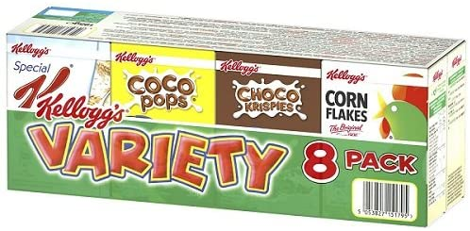
Examples of the 3Rs
Reduce
Think before you buy and only buy things that you need
Redesigning items so that they use fewer resources to make them
Think about the packaging before you buy
8 servings
Which will make more waste?
24 servings
8 Cardboard boxes
1 Cardboard box
8 inside bags
1 inside bag
No plastic film
All wrapped in plastic film
£4.00 or 16p a serving
£2.30 or 29p a serving

Slide 11
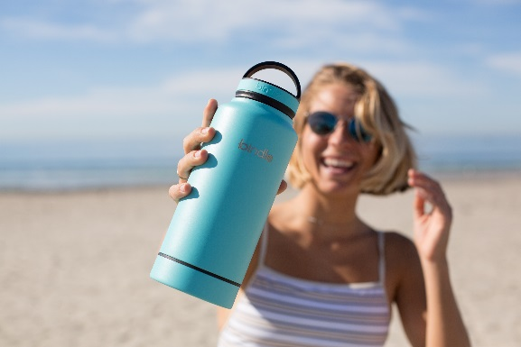
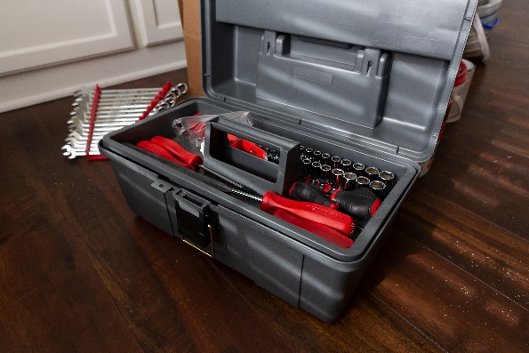
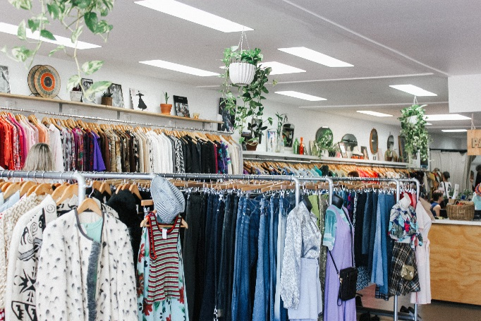
Examples of the 3Rs
Reuse
Using reusable items instead of disposable ones e.g. water bottles and shopping bags
Repairing broken items instead of throwing them away
Buying second hand rather than new e.g. furniture, toys and clothes

Slide 12
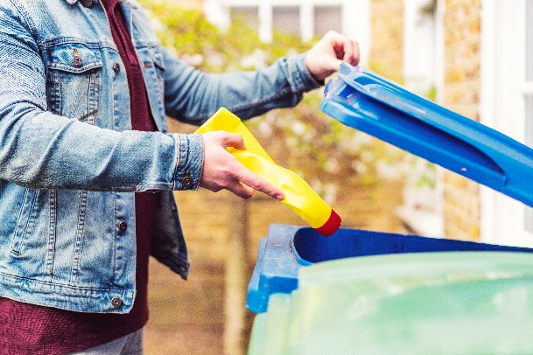
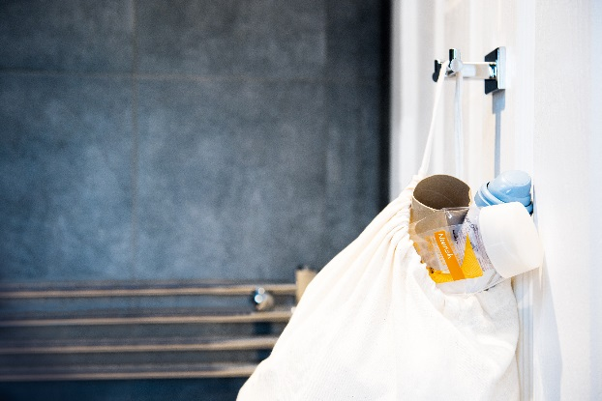
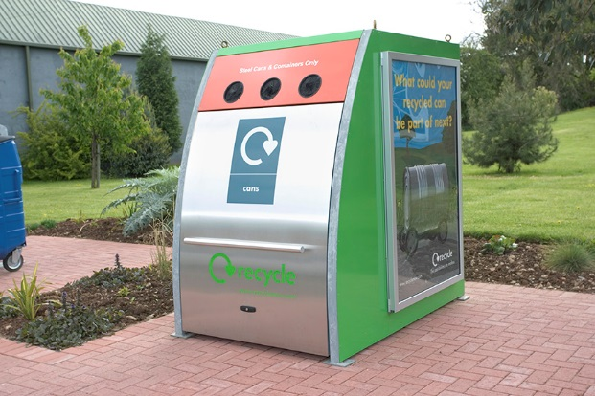
Examples of the 3Rs
Recycling
Putting the correct items in the correct bins at home (and, if possible, at school)
Keeping a recycling bin in your bedroom or bathroom
Taking your recycling to the recycling centre or bring bank
Raise your hand if you recycle at home

Slide 13
Recycling rates by country
1. Germany
65%
2. South Korea
3. Austria
58%
59%
13. United Kingdom
45%
Notes:
Germany 65%
South Korea 59%
Austria 58%
UK 45%

Slide 14
Recycling rates in South Yorkshire
Barnsley: 46.5%
Doncaster: 46.4%
Rotherham: 44.6%
Sheffield:
31%
*Data from 2018/19

Slide 15
To help bin-workers, we sort our waste into different colour bins

Slide 16
In Rotherham, we have 4 bins
The green bin
Envelopes
Newspapers
Cardboard

Slide 17
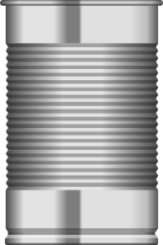
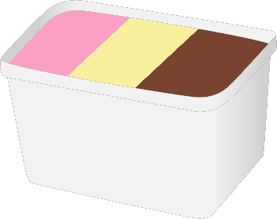
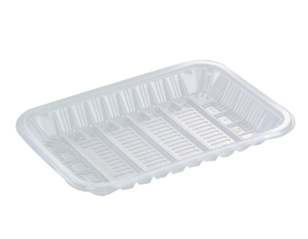
In Rotherham, we have 4 bins
The black bin
Plastic
Bottles
Plastic pots
Tins
Cans
Plastic tubs
Glass jars
Glass bottles
Plastic trays

Slide 18
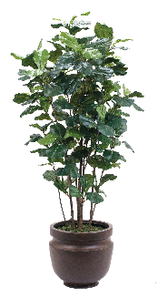
In Rotherham, we have 4 bins
The brown bin
Leaves
Flowers
Leaves
Plants
Grass cuttings

Slide 19
In Rotherham, we have 4 bins
The pink lid bin
Nappies
Food waste

Slide 20
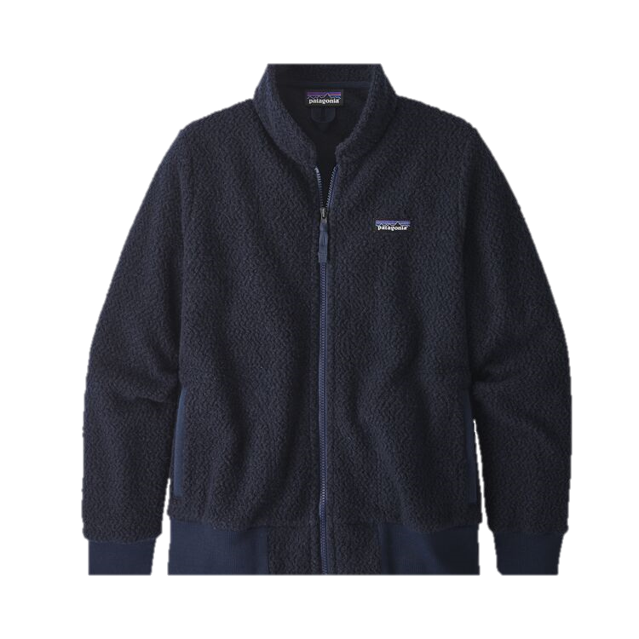
Why should we recycle?
Recycling means we can turn our waste into new things!

Slide 21
Why should we recycle
Recycling saves our resources
Many of the resources we use are finite meaning that they take a long time to replenish and therefore can be very limited.
The more materials and products we make, the quicker our resources get used.
It is important to recycle so that we can keep our resources useful for longer
Resources
‘Stuff’ we make

Slide 22
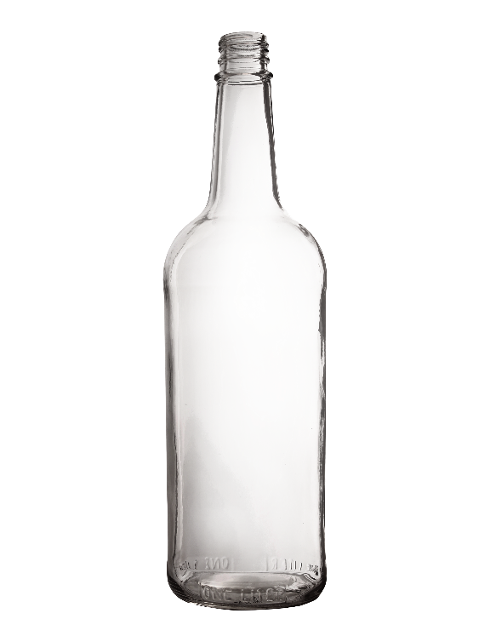
Why should we recycle?
Recycling saves energy!
By recycling just one glass bottle, enough energy is saved to power a light bulb for four hours.

Slide 23
Why should we recycle?
Becoming more sustainable
By recycling at home, we are helping to achieve these goals!

Slide 24
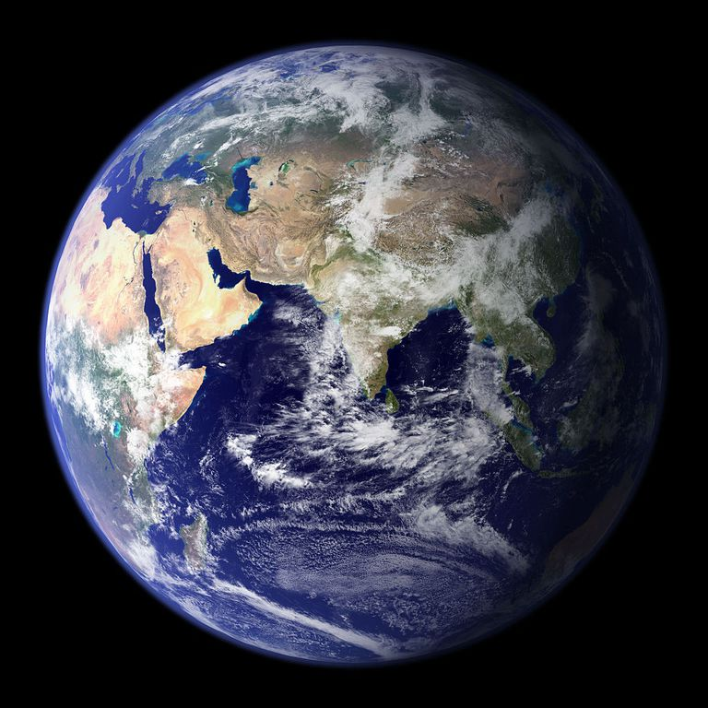
Why should we recycle?
Recycling saves our planet
If the entire planet used resources at the rate the UK does, we would need 2.4 Earths to support us
We only have one planet Earth, so it is really important that we look after it!

Slide 25
How can you help?
Remember the 3 R’s!
Make less waste in the first place
Reduce
Reuse
Recycle
Use things again instead of throwing them away
Recycle the correct things as much as possible so that they can be made into new things

Slide 26
The 3Rs at home and school
Shop smartly and think about the waste created by the packaging
Use a reusable water bottle rather than a disposable one
Donate any of your unwanted clothes to charity or give them to friends and family
Use reusable batteries
Have a recycling bin your bathroom and bedroom so that you don’t forget anything!
Put things in the correct recycling bin at home. If you are unsure, ask your parents or check on your Council’s website

